Slide 1
Celtic
Interconnector
Community Forum – 14th September 2021
Notes:
13/22/20/23/27

Slide 2
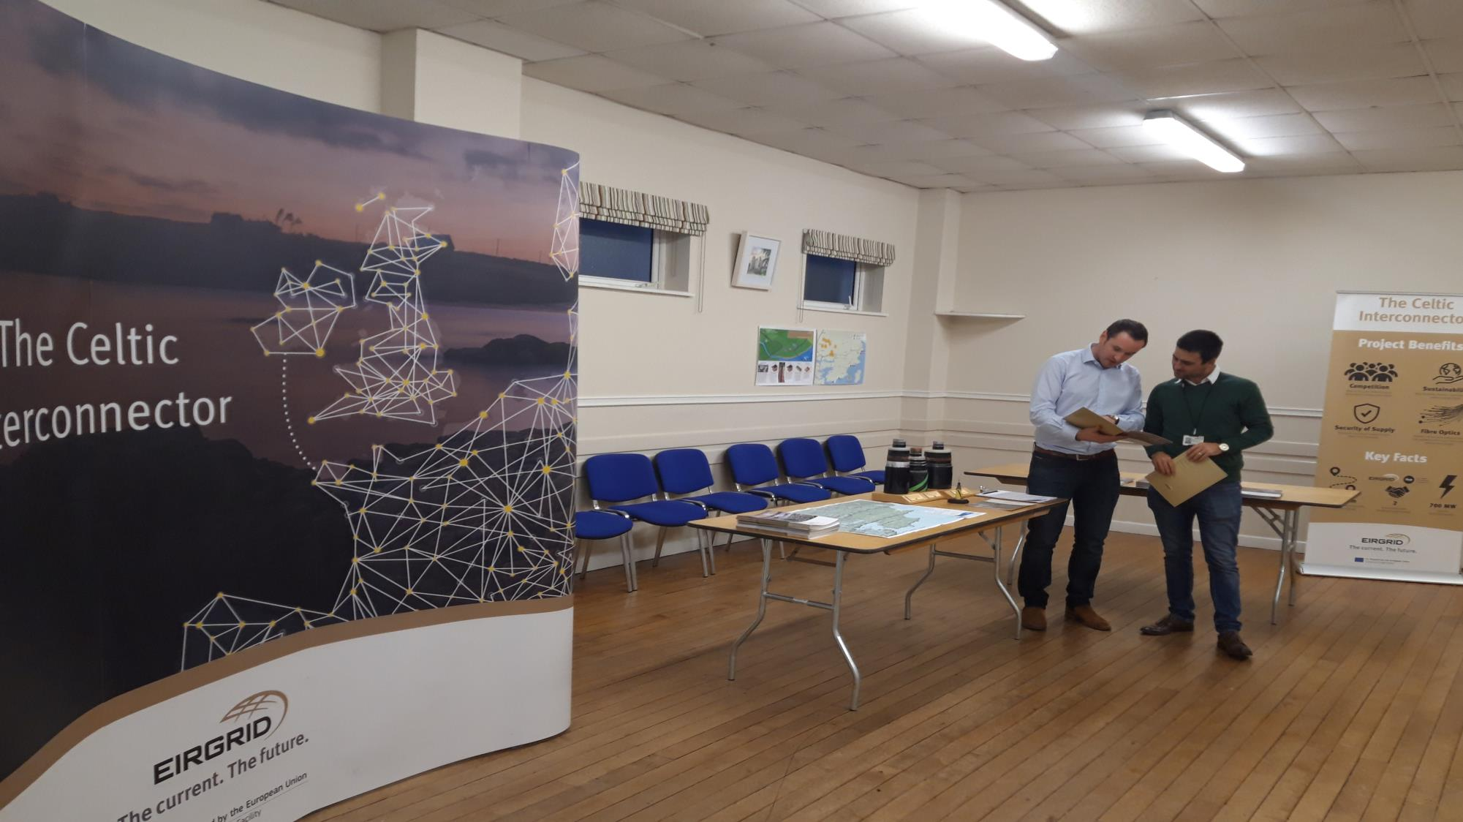
Agenda
Introduction from the Chair
Round table introductions
Focus of the Forum – Terms of reference recap
Working together – principles and agreement
Brief project update.
Background on Community Benefit – where it has come from and where it’s going;
Send in suggestions for agenda of next meeting
Date and time of next meeting(s)
AOB

Slide 3
Housekeeping
Meeting is recorded
Microphones off until talking.
Rename yourself with Name/ Organisation (if representing one)
Please write in the chat (Questions or Comment)
Raise hand to speak
Respect for everyone at the meeting

Slide 4
Round Table Introductions
Please turn on your camera and microphone
Introduce yourself and the group/groups you are representing
Tell us why you joined the forum and what your expectations are.

Slide 5
The Celtic Community Forum
Comprises of local representatives of the Celtic Communities.
Independently chaired by Irish Rural Link
Meets according to need, but approximately 4 times a year
Membership spread across project area
Representatives of community groups and associations
Local elected representatives
Notes:
Stakeholders who are not part of the forum can still participate in future consultations and throughout EirGrid’s grid development process.

Slide 6
The role of the forum?
The Community Forum brings together key stakeholders in the community to:
Represent the views of their organisation or community in relation to the project and its proposals;
Consider the project and provide guidance on local needs and priorities;
Assist in the resolution of local issues resulting from the project in a timely manner.
Support the project team in identifying local sources of information and analysis, strategies and proposals
Provide feedback at key stages in the delivery of the project
Facilitate a ‘local voice’ and communicate information to local stakeholders.

Slide 7
Working together – principles and agreement
Community Development Principals
IRL will take the minutes and are in draft form until agreed at the next meeting
Community Groups to be mentioned rather than individuals?

Slide 8
General overview & update
Current Status in Ireland
Application for planning consent is currently with An Bord Pleanála (ABP)
(ABP) Public Consultation period closed on 06 September
Awaiting ABP response
Key project characteristics:
500 km of submarine cable
Landfall location at Claycastle Beach in Youghal.
Approx. 35 km underground DC and AC cable.
Converter station at Ballyadam, Carrigtwohill
Network connection point at Knockraha 220 kV substation.
Main benefits of the project:
Enable the energy transition in Europe, especially in Ireland and in France
Direct connection between Ireland and the EU internal electricity market
Improve security and reliability of supply
Providing a direct telecommunications link between Ireland France ( and continental Europe)

Slide 9
Community Benefit Update
Planning consent
Break ground on construction
Midway through cabling
Energisation of project
Project Milestone
Community Benefit Milestone
Appoint Community Benefit Administrator
Develop Community Benefit Strategy for project area
Release 40% of funds (phase 1)
Release 30% of funds (phase 2)
Release 30% of funds (phase 3)

Slide 10
Community Benefit Strategy for Celtic
Purpose:
Maximise the impact of community benefit.
Leave a positive legacy locally.
Distribute benefit in a planned, fair and sustainable way.
Content:
Explore scope
Identify gaps and needs
Conduct a SWOT analysis
Identify local priorities
Identify potential partnerships and matched funding
Strategy must be complete before first phase of funding is released.

Slide 11
AOB and Next Meeting
Please suggest agenda items for the next meeting
Next meeting agenda items to be sent to michelle.walsh@eirgrid.com or james@irishrurallink.ie.

