Slide 1
Celtic
Interconnector
Community Forum – 8th March 2022
Notes:
13/22/20/23/27

Slide 2
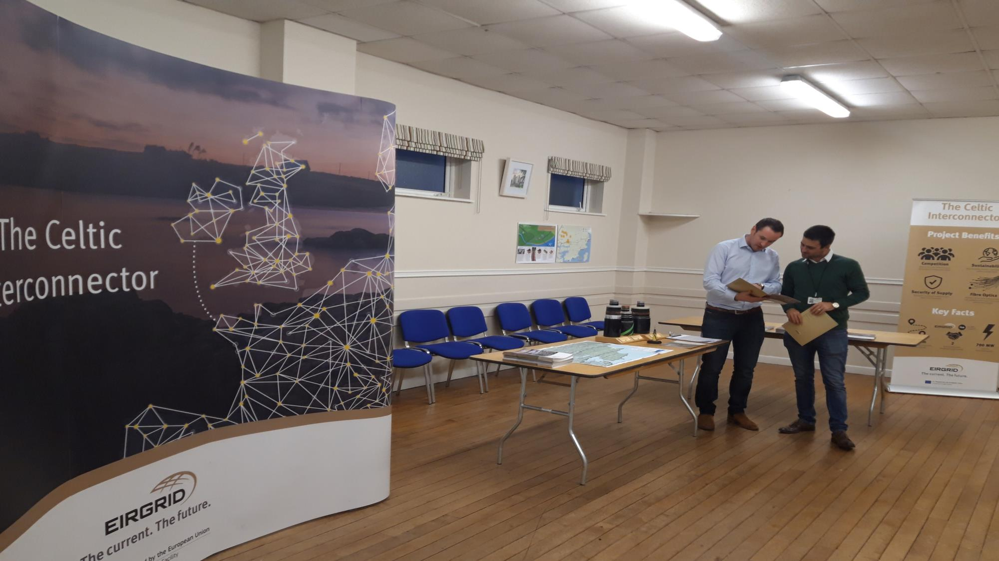
Agenda
Welcome
Minutes proposed for sign off
Brief project update
Speaker – Bobby McCormack Development Perspectives
Q&A
Date and time of next meeting(s) 2022
AOB

Slide 3
Housekeeping
Meeting is recorded
Microphones off until talking.
Rename yourself with Name/ Organisation (if representing one)
Please write in the chat (Questions or Comment)
Raise hand to speak
Respect for everyone at the meeting

Slide 4
General overview & update
Project Status in Ireland
Determinations pending on all consents.
Tender process is ongoing.
Community Benefit Fund
Responses to tenders for appointment of Grant Fund Administrator have been received.
Appointment will be after the planning determination update from An Bord Pleanála.
Engagement
An information event was held at Knockraha on 15th/16th February.
Key information shared was the project design decision to move the cable sealing end from Ballyadam to Knockraha.
Proposed Information days in March in East Cork.
Notes:
Questions for the forum:
Do members of the Forum feel East Cork stakeholders would be interested in attending an open day in March?
Are members of the Forum comfortable to have their contact details shared with stakeholders on request?

Slide 5
Sustainable Development Goals
Bobby Mc Cormack
https://www.developmentperspectives.ie/

Slide 6
Community Benefit Update
Planning consent
Break ground on construction
Midway through cabling
Energisation of project
Project Milestone
Community Benefit Milestone
Appoint Community Benefit Administrator
Develop Community Benefit Strategy for project area
Release 40% of funds (phase 1)
Release 30% of funds (phase 2)
Release 30% of funds (phase 3)

Slide 7
AOB and Next Meeting
Confirm meeting dates for 2022 – preferred day of week; time etc.
Next meeting agenda items to be sent to michelle.walsh@eirgrid.com or james@irishrurallink.ie.

Slide 8
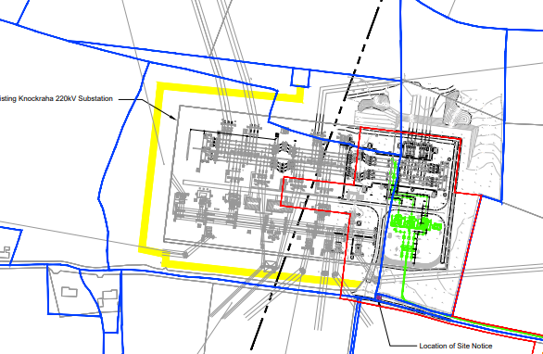
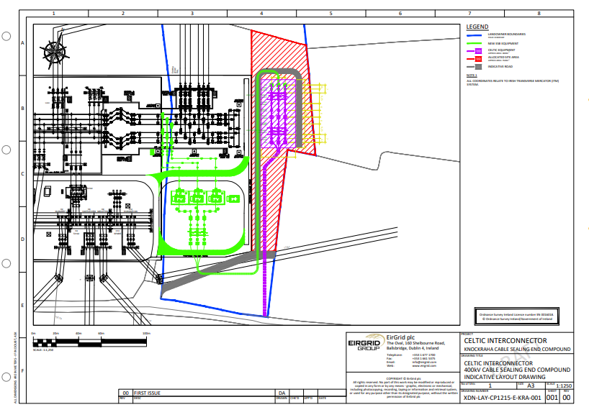
What is required?
• Cable Sealing End required to separate
the EirGrid Celtic Interconnector from ESB
owned infrastructure.
How is it consented?
• For Strategic Infrastructure Development projects, subsequent modifications
to consented development can be requested from An Bord Pleanála.
https://www.eirgridcelticinterconnector.ie/plans-and-drawings/Knockraha-Substation-and-Typical-Consstruction-Compound-Drawings.zip

Slide 9
Community Benefit Strategy for Celtic
Purpose:
Maximise the impact of community benefit.
Leave a positive legacy locally.
Distribute benefit in a planned, fair and sustainable way.
Content:
Explore scope
Identify gaps and needs
Conduct a SWOT analysis
Identify local priorities
Identify potential partnerships and matched funding
Strategy must be complete before first phase of funding is released.

