Slide 1
DS3 System Services Volume Uncapped Gate 14 Bidders’ Information Session
17TH December 2025
Please keep mic muted
Please keep video off
Raise queries during webinar to DS3@EirGrid.com

Slide 2
Agenda
Topic | Speaker
Introduction | David Howlett
Procurement Process Overview | Jamie Cosgrove
Q&A | Attendees
Tender Pack and Technical Questionnaire | David Howlett
Q&A | Attendees
Testing and Signalling Requirements | Jennifer Monaghan
Q&A | Attendees
Closing Comments | David Howlett
Webinar Ends | -

Slide 3
Introduction
Post webinar, queries can be emailed in the clarification template to tenders@eirgrid.com ,tenders.soni@soni.ltd.uk
Closing date for receipt of queries is 12 noon on 5th January 2026.
The presentation slides will be made available on eTenders/mytenders and on the EirGrid website.
Notes:
We would ask all attendees to mute their line during the presentations.
Q&A:
- We will endeavour to answer some queries received during the webinar, at the end of each section
All queries will receive a written response

Slide 4
Procurement Process Overview

Slide 5
Qualification System
Qualification System – refers to the system that is in place to enable interested parties to submit a Response and subsequently qualify for award of Contract for provision of DS3 System Services (under Volume Uncapped Arrangements).
Qualification System lasts until September 2027 or the introduction of FASS.
24 System Services are being procured as part of the Qualification System for Gate 14, ( 12 for EirGrid and 12 for SONI). The services for DRR and FPFAPR may be added at a future date.
12 services have been procured to date in accordance with Phase 1 and Phase 2 in 2018, Gate 1 in September 2019, Gate 2 in April 2020 , Gate 3 in October 2020, Gate 4 in April 2021, Gate 4B in July 2021, Gate 5 in October 2021, Gate 6 April 2022, Gate 7 October 2022 and Gate 8 April 2023, Gate 9 in October 2023, Gate 10 in April 2024, Gate 11 in October 2024, Gate 12 in April 2025 and Gate 13 in October 2025.
Notes:
Volume Uncapped aka Regulated Arrangements
Contract Entities: EirGrid and SONI

Slide 6
Gate Process
Gate Process – Occurs twice a year in April and October, where service providers can gain entry to participate, or amend services, in the energy market.
New applicants may submit a completed Response for a place on the Qualification System at any time during the tender window.
It is intended that specific contracts will be awarded every six months – these periods are referred to as Gate Dates. EirGrid will issue periodic notices on the OJEU / EirGrid websites outlining the requirements and timeframes involved. Indicative dates are contained in the briefing document.
Exception to the 6-month process is Gate 4-B.
Notes:
Note that to date we have maintained the 6-monthly gate process, which has given certainty to industry

Slide 7
DS3 System Services Agreement
This procurement is being run jointly by EirGrid and SONI for their respective DS3 System Services Agreement.
A separate DS3 System Services Agreement is in place for:
EirGrid (as contracting entity for the DS3 System Services Agreement applicable to Ireland) and
SONI (as contracting entity for the DS3 System Services Agreement applicable to Northern Ireland).
Existing holders of an agreement will receive an amended Schedule 9; new parties to the Qualification System will receive an agreement dated 1st April 2026.

Slide 8
Gate 14
E tenders: CFT 7168696 - ENQEIR992 – OJUE: 828557-2025 - DS3 System Services – Volume Uncapped – Gate 14 published on the 10th December 2025
Mytenders: RFT reference: Ref No: 2025/S 000-082303 - Procurement identifier (OCID): ocds-h6vhtk-05f475 - SONI074 DS3 System Services – Volume Capped – Gate 14 published on the 12th December 2025
Two stages in this procurement process (submitted together):
Pre-Qualification; and
Tender
Lots
Lots 1-12 IE
Lots 1-12 NI
Documents available on eTenders www.etenders.gov.ie ,
www.mytenders.co.uk ,
https://www.findtender.service.gov.uk/Notice/082303-2025

Slide 9
Gate 14
Gate 14 applies to 3 scenarios:
Providing Unit that is not currently contracted for the provision of any System Service and wishes to tender for one, some or all services;
Providing Unit intends to amend its contracted values for a service that it currently provides (this may be enhancing or reducing its capability);
Providing Unit that is contracted for the provision of one or more services and wishes to tender for additional services.
Providing Units that do not wish to amend their existing provision of a particular service must not submit a tender for the respective Lot.
Tenderer will receive a new agreement
Tenderer will receive an amended Schedule 9
Notes:
A new agreement dated 1st October 23 applies to scenario 1
A letter of amendment with revised schedule 9 applies to scenarios 2 and 3

Slide 10
Gate 14 Lot Numbers – EirGrid
Existing Services
POR L1IE | Primary Operating Reserve | SSRP L7IE | Steady State Reactive Power
SOR L2IE | Secondary Operating Reserve | SIR L8IE | Synchronous Inertial Response
TOR1 L3IE | Tertiary 1 Operating Reserve | RM1 L9IE | Ramping Margin 1 Hour
TOR2 L4IE | Tertiary 2 Operating Reserve | RM3 L10IE | Ramping Margin 3 Hour
RRD L5IE | Replacement Reserve (De-Synchronised) | RM8 L11IE | Ramping Margin 8 Hour
RRS L6IE | Replacement Reserve (Synchronised) | FFR L12IE | Fast Frequency Response

Slide 11
Gate 14 Lot Numbers – SONI
Existing Services
POR L1NI | Primary Operating Reserve | SSRP L7NI | Steady State Reactive Power
SOR L2NI | Secondary Operating Reserve | SIR L8NI | Synchronous Inertial Response
TOR1 L3NI | Tertiary 1 Operating Reserve | RM1 L9NI | Ramping Margin 1 Hour
TOR2 L4NI | Tertiary 2 Operating Reserve | RM3 L10NI | Ramping Margin 3 Hour
RRD L5NI | Replacement Reserve (De-Synchronised) | RM8 L11NI | Ramping Margin 8 Hour
RRS L6NI | Replacement Reserve (Synchronised) | FFR L12NI | Fast Frequency Response

Slide 12
Tender Response
Tenderers must submit a separate standalone tender for each and every Providing Unit.
Note: A Tenderer may have more than one Providing Unit.
Tenders should be split into two constituent parts (submitted at the same time):
A pre-qualification section; and
A tender section.
Tenderers’ response for each Providing Unit should consist of:
Part 2 of the Qualification System Briefing Document, including Forms 1, 2 and 3; and
A Completed Technical Questionnaire sheet for each Lot they are submitting for (must be completed in Excel).
Notes:
Pre-qualification consists of forms 1, 2 and 3.
Tender section consists of the technical questionnaire.

Slide 13
Tender Evaluation
All Responses will be evaluated, on a lot-by-lot basis and Providing Unit basis, against the qualification and award criteria outlined in the tender pack.
Tender evaluation:
against the Pass / Fail pre-qualification minimum requirements for the lot concerned; and
against the award criteria for compliance in line with the technical requirements for the lot concerned.
As the payment rate (tariff) for each System Service will be fixed, Responses will be assessed under the award criteria based upon quality (technical compliance) only.
Notes:
The technical requirements are set out in the technical questionnaire.

Slide 14
Tender Queries
Queries Arising from this Webinar
We will verbally answer some queries received via Q&A today.
Formal response will issue to all Tenderers which may supersede information provided today.
We request Tenderers to formally submit queries via email.
General Queries
Submit by email.
In Clarification Template.
Not later than 12:00 noon Irish Time on 5th January 2026.
Addressed to: Jamie Cosgrove and email tenders@eirgrid.com
EirGrid anticipate to respond to all queries by 6th January 2026.
Notes:
Any queries from today we will attempt to answer – it may be necessary to take some away, in which case any formal response will supersede any verbal responses today.
Note the date for the final submission of written queries – 25/06 – this coming Tuesday.
EirGrid must ensure that all queries are responded to by 02/07/2021.

Slide 15
SONI vs EirGrid Submissions
All submissions intended for SONI – DS3 System Service – Volume Uncapped – Gates, should be submitted using the United Kingdom Tenders Platform only, www.mytenders.co.uk.
All submissions intended for EirGrid – DS3 System Service – Volume Uncapped – Gates, should be submitted using www.etenders.gov.ie
Please register your company on www.myTenders.co.uk to receive notice of any potential SONI contract notices for DS3 System Service Gates. SONI will not accept any tender submission which has not been uploaded to the www.myTenders.co.uk tender box prior to the SONI tender closing time. Please note, we will not accept any SONI tender submissions for DS3 System Service Gates through the www.etenders.gov.ie platform, this platform should be used for EirGrid submissions only. SONI is not responsible for any impact on any tenderer who does not submit their SONI tender through the correct platform as outlined above.
If you require assistance with registering on www.mytenders.co.uk website or are having difficulty uploading your tender response to the website, please contact their helpdesk on 0800 2229006. SONI cannot provide technical assistance with this website.
Tenderers should email tenders.SONI@soni.ltd.uk for SONI queries or clarifications, thank you.

Slide 16
Submission of Tenders
Interested Tenderers must submit a tender response through the eTenders portal in respect of the relevant Lot for EirGrid and myTenders portal in respect of the relevant Lot for SONI.
Tender box close time for EirGrid submissions 12 noon, Irish Time, on Thursday 15th January 2026 – eTenders will not allow upload after this time.
Tender box close time for SONI Submissions 12 noon, GMT Time, on Thursday 15th January 2026 – myTenders will not allow upload after this time.
The Tenderer is fully responsible for the timely delivery of the tender.
Tenderer must log in early and ensure you are registered to submit your tender documents. Go to the website www.etenders.gov.ie for EirGrid or www.mytenders.co.uk for SONI and follow their instruction relating to registration requirements.
Notes:
No hard-copy tenders or anything on a disk (as per Phases 1 and 2).
Through eTenders portal only – please familiarise yourself well in advance of submission, ensure registration is complete, you’re not locked out etc.
There is an eTenders site helpline.

Slide 17
Tender Timetable
Event | Date
Open for Submission of Queries | From Tender Notification
Deadline for Submission of Queries | No later than 12:00 hrs (Irish Time) on 5th of January 2026
EirGrid and SONI to Respond to Queries | By close of business on (Irish Time) on 6th January 2026
Deadline for Submission of Tenders | No later than 12:00 hrs (Irish Time) on 15th January 2026
Notification of Successful Tenderers | 4th March 2026 (Indicative)
Standstill Period | 14 days from Notification Date
Contract Commencement | 1st April 2026
Notes:
To recap some key dates…

Slide 18
Procurement Process Overview
Q & A
TSOs will provide a verbal response to queries received during the webinar.
All queries will receive a written response following the webinar.

Slide 19
Tender Pack and Technical Questionnaire

Slide 20
Contractual Arrangements
Scenario 1 – agreement is dated 1 April 2026
DS3 System Services Agreement
Protocol Document
Operational Requirements
Performance Scalar Details
Statement of Payments
Performance Monitoring Methods and infrastructure requirements
Standard contractual provisions
Schedules for 14 DS3 System Services
Scaling Factor details
DS3 System Service Payment rates
Term
Governance
Product Scalars
Locational Scalar
Temporal Scarcity Scalar values
Clause 15.1 – Changed from Counterparts to Electronic Signature clause
Scenario 2 & 3 – amended Schedule 9 via Side Letter
Version 4.1 – Effective 1 October 2024

Slide 21
Service Maximum Capability Volumes
Briefing Document Section 1.6.4 – maximum capability volumes to apply per service.
Service | Max Volume - Normal Operation | Max Volume - Requested by TSO
FFR | 75 MW | 100 MW
POR | 75 MW | 100 MW
SOR | 75 MW | 100 MW
TOR1 | 75 MW | 100 MW
TOR2 | 75 MW | 100 MW
RRD | 300 MW | N/A
RRS | 300 MW | N/A
RM1 | 450 MW | N/A
RM3 | 500 MW | N/A
RM8 | 500 MW | N/A
SSRP | 400 Mvar | N/A
SIR | 120,000 MWs² | N/A
Notes:
No change from Gate 4 but worth reiterating:
A Providing Unit will be contracted for a maximum volume of up to 75 MW for the FFR, POR, SOR, TOR1 and TOR2 services. This contracted volume may be increased to a maximum of 100 MW on request of the TSO and with the agreement of the service provider where required operationally.
Subject to a unit demonstrating the upper capability.
Broader rationale for this change: The TSOs have general concerns regarding the concentration of large amounts of reserve provision in a small number of units; in the future it is preferable from a system security perspective to schedule reserve provision from a broader range of units and technologies.
Note the above may be modified or changed during the lifetime of the Qualification System. Any modifications will apply to new contracts and will be communicated ahead of each gate.
Previous: FFR – 100; POR – 100; SOR – 125, TOR1 – 150; TOR2 – 150.

Slide 22
Technical Questionnaire
Excel document that is used to determine a unit’s technical capability to provide a service
Technical Questionnaire contains:
General Guidance sheet
Reserve Characteristic and PQ Capability sheets
System Services Site Info sheet for aggregated Providing Units
Individual sheet for each Lot, plus general information and unit information

Slide 23
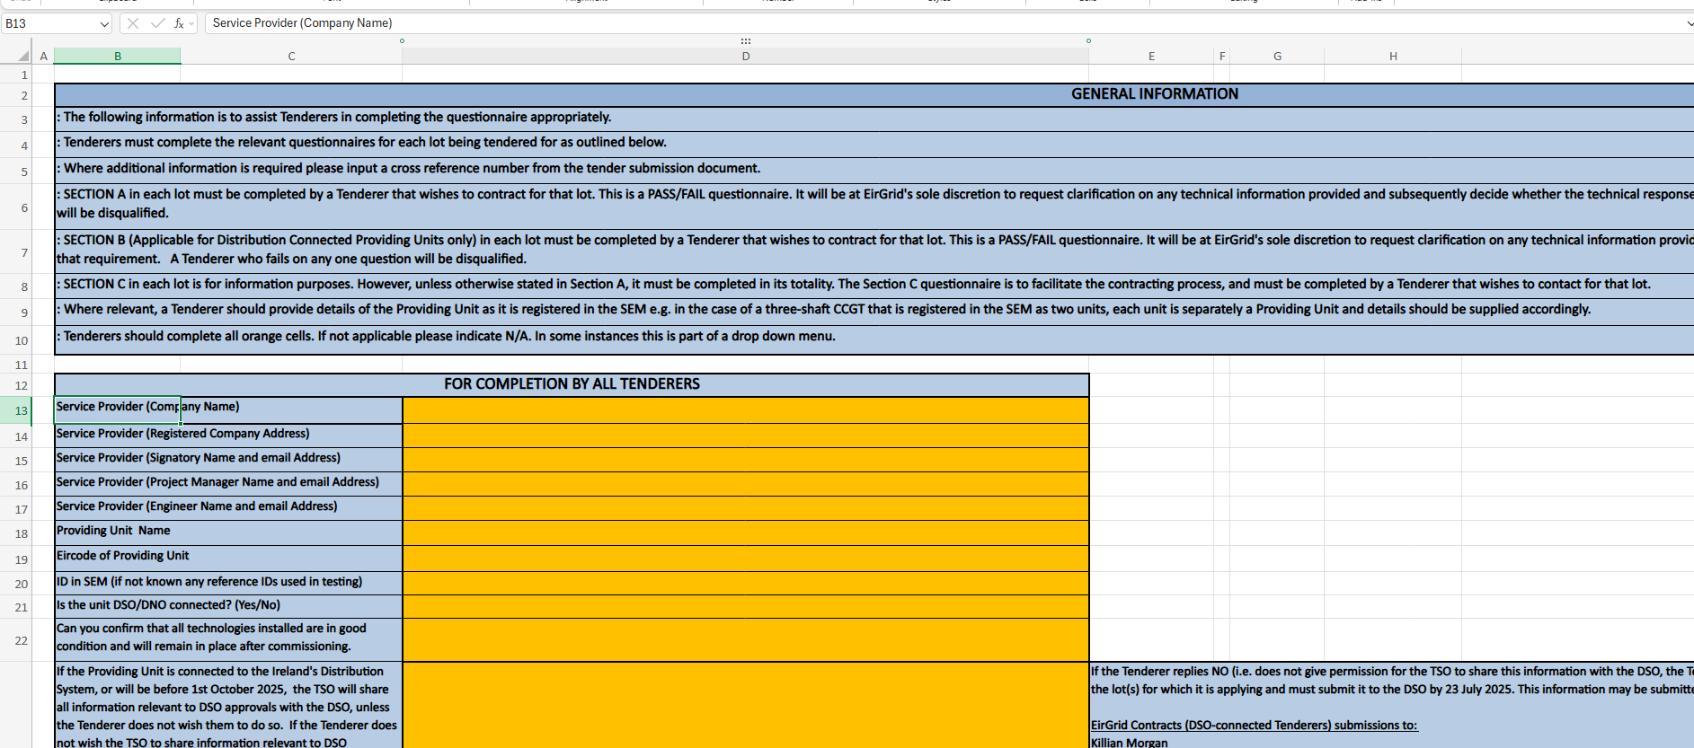
Technical Q - Guidance Sheet
Section A is Pass/Fail for all Providing Units.
Section B is Pass/Fail for Distribution Connected Providing Units.
Section C is required information and must be completed as specified.
All Providing Units must complete this sheet, including the Lots being tendered for.
For Distribution Connected Providing Units, TSO will share relevant information with the DSO/DNO if tenderer permits.
Notes:
Animation:
Instructions for completing the Lots are contained in the General Information section at the top of the Guidance Sheet.
Tenderer must complete the guidance sheet.
Simple rule – anything in orange must be completed as applies to the Providing Unit and the section.

Slide 24
Technical Q – Reserve Characteristic
If the unit is multi-fuel, complete a table for each fuel type.
Notes:
Applicable to services FFR to RRD/RRS.
Generator Testing will provide more information on support available for completing the reserve characteristic sheet if a unit is testing. There is also a tool available on the EirGrid website.

Slide 25
Technical Q – PQ Capability
Notes:
Applicable to the SSRP service only.

Slide 26
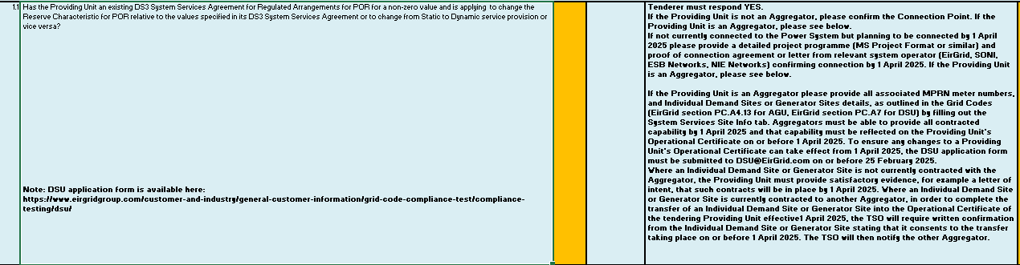
Sample Lot – Section A
Section A.1 is for Candidates that are applying to amend their existing contracted service values.
There are two sections, one for new entrants and on for current. You will need to make sure you only fill in the one appropriate to you
Aggregators take note of Q1.1 – specifically relating to individual sites that are not currently contracted with the Providing Unit.
The revised technical questionnaire requests that DSUs submit the Application form associated with their Operational Certificate at least 6 weeks prior to Contract execution.
Notes:
We will review a sample Lot – in this case POR, but the same general rules apply to completion of every Lot
We would ask Aggregated units to take note re Q1.1 and the amended text from Gate 5. More on the next slide.

Slide 27
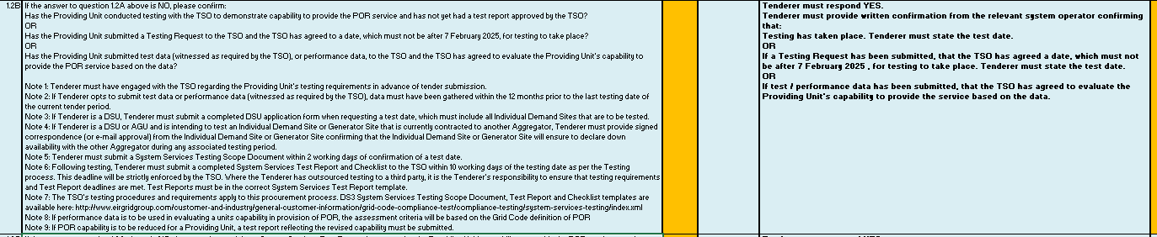
Sample Lot – Section A
Also included a note for existing units stating that if capability is to be reduced a revised test report reflecting the reduced values must also be submitted.
Additional note for tenderers who opt to submit test data or performance data.
Notes:
We will review a sample Lot – in this case POR, but the same general rules apply to completion of every Lot
We would ask Aggregated units to take note re Q1.1 and the amended text from Gate 5. More on the next slide.

Slide 28
Aggregator Site Switching
A service provider managing an aggregated DSU / AGU may submit a tender in respect of a Providing Unit comprising a list of constituent sites where for such sites there is either:
an active contract in place between the service provider and the site; or
where a site is not currently contracted with the Aggregator, satisfactory evidence, for example a letter of intent, that such contracts will be in place by 1st April 2026.
All necessary testing as specified under the procurement rules must be completed by the deadlines specified within the procurement.
Notes:
TBC will talk more about this later.
All other DSU requirements are to remain as is e.g. SEM registration, requirement for DSO/DNO consent.

Slide 29
System Services Site Info
 | Site No. | Tenderer should align the Site no. with site numbers listed in the DSU Application form / AGU Application form / DSU Ops Cert / GASOA Schedule | 1 | 2 | 3 | 4 | 5 | 6 | 7
1 | Is this site providing DS3 System Services? | Yes / No | Please Select from Drop Down List | Please Select from Drop Down List | Please Select from Drop Down List | Please Select from Drop Down List | Please Select from Drop Down List | Please Select from Drop Down List | Please Select from Drop Down List
2 | Name of Individual Demand Site |  | <Insert Here> | <Insert Here> | <Insert Here> | <Insert Here> | <Insert Here> | <Insert Here> | <Insert Here>
3 | MPRN |  | <Insert Here> | <Insert Here> | <Insert Here> | <Insert Here> | <Insert Here> | <Insert Here> | <Insert Here>
4 | Irish Grid Co-ordinates of the Connection Point |  | <Insert Here> | <Insert Here> | <Insert Here> | <Insert Here> | <Insert Here> | <Insert Here> | <Insert Here>
5 | Maximum Export Capacity | (MW) | <Insert Here> | <Insert Here> | <Insert Here> | <Insert Here> | <Insert Here> | <Insert Here> | <Insert Here>
6 | Maximum Import Capacity | (MW) | <Insert Here> | <Insert Here> | <Insert Here> | <Insert Here> | <Insert Here> | <Insert Here> | <Insert Here>
7 | Performance Measurement Device Standards for Fast Acting Services installed in agreement with TSO. | Yes / No | Please Select from Drop Down List | Please Select from Drop Down List | Please Select from Drop Down List | Please Select from Drop Down List | Please Select from Drop Down List | Please Select from Drop Down List | Please Select from Drop Down List
8 | The Trigger Point that the IDS is expected to start responding at (F Trigger On). | (Hz) | <Insert Here> | <Insert Here> | <Insert Here> | <Insert Here> | <Insert Here> | <Insert Here> | <Insert Here>
9 | The frequency range over which the IDS will go from minimum to maximum declared response (F Trigger Range). | (Min Hz - Max Hz) | <Insert Here> | <Insert Here> | <Insert Here> | <Insert Here> | <Insert Here> | <Insert Here> | <Insert Here>
10 | The frequency at which the IDS will begin to cease responding at (F Trigger Off). | (Hz) | <Insert Here> | <Insert Here> | <Insert Here> | <Insert Here> | <Insert Here> | <Insert Here> | <Insert Here>
11 | Time delay to the F Trigger Off characteristic that the IDS will continue to respond for thereafter (T loiter). | (sec) | <Insert Here> | <Insert Here> | <Insert Here> | <Insert Here> | <Insert Here> | <Insert Here> | <Insert Here>
12 | Minimum time duration following a response before the IDS will become available to respond again (T Min Interval). | (sec) | <Insert Here> | <Insert Here> | <Insert Here> | <Insert Here> | <Insert Here> | <Insert Here> | <Insert Here>
This must be completed for all aggregators' sites
Notes:
Staying with aggregators.
The Site Info tab must be completed by aggregators. This was used in Phase 2 and Gate 1, Gate 2 and Gate 3.
The format aligns with the DSU application form.

Slide 30
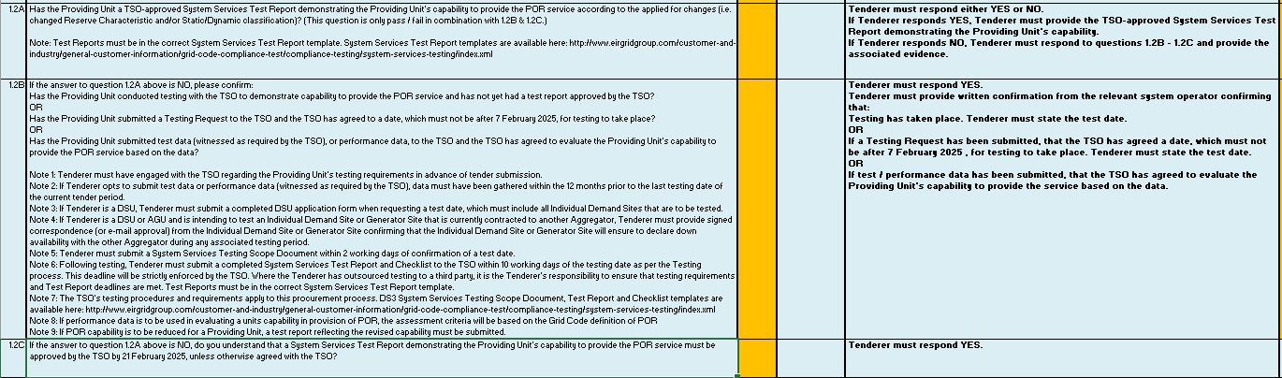
Sample Lot – Section A – Testing
We encourage units to test early!
Does the tenderer have an approved test report?
3 questions relate to Testing – apply to all Providing Units and taken together are Pass / Fail
If not, tenderer must satisfy one of 3 conditions:
Have already tested, or
Have an agreed test date before 06/02/2026, or
Have agreed with the TSO to use test data. Data must have been gathered within the 12 months.
All units must have engaged with the TSO in advance of tender submission and agreed a testing plan.
Approved test report is required by 20/02/2026. Make sure Generator Testing receive the reports
Testing deadlines will be enforced for the Gate.
It is the tenderer’s responsibility to ensure that testing activities are conducted within the required timeframes.
Notes:
Testing questions apply to all Providing Units.
Has the unit submitted an approved test report with the tender
If not, has the unit:
Undertaken testing but not yet completed a test report
Agreed a testing date with the TSO, not later than 6 August
Agreed with the TSO that test / performance data can be used to demonstrate capability to provide the service
Evidence is required for all of the above.
Testing deadlines will be enforced.
Tenderers are responsible for ensuring that deadlines are met – important where the testing is being outsourced.

Slide 31
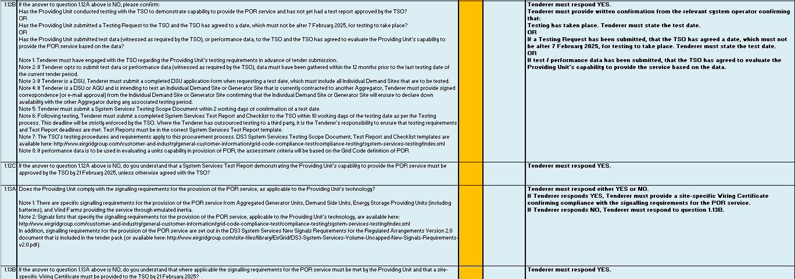
Sample Lot – Section A – Signals
Does the unit comply with the Signalling requirements for the service? Specific Signalling requirements are noted per Lot.
Questions relate to Signalling – apply to Providing Units depending on the technology and the service being tendered for.
Site specific wiring cert is required by 20/02/2026 for new units (aspiring entrants).
Notes:
No change to the signalling requirements from Gate 5.
Signals are service and technology dependent.
The signals lists specify all of the requirements for each technology type and service.

Slide 32
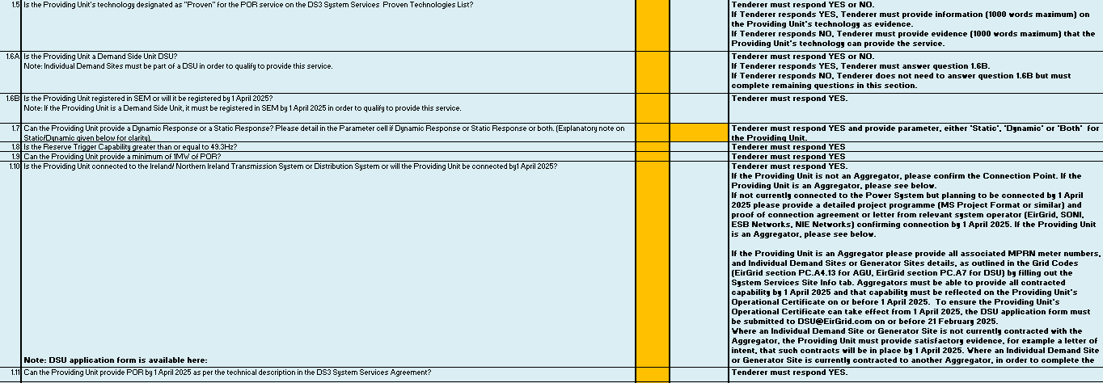
Sample Lot – Section A
Section A.2 is for Tenderers that do not currently provide the service in the Lot.
Is the unit’s technology on the proven list?
Can the unit provide the minimum service vol?
Additional Pass / Fail questions apply to aspiring entrants, including:
Is the unit connected to the transmission or distribution system?
Pass / Fail Questions relating to Testing and Signalling (where applicable to the technology and service) are the same as Section A.1.

Slide 33
Sample Lot – Section B
Section B is for Distribution- Connected Candidates only.
Notes:
This relates to the requirement to have authorisation from the DSO / DNO to provide the service(s) in the form of a Letter of Consent.

Slide 34
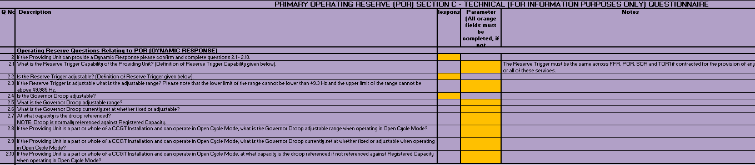
Sample Lot – Section C
Section C is for information required for billing and monitoring purposes and must be completed as specified.
Tenderers must specify the total contracted volume that is being applied for, and state weather they want to use a higher value based on the outcome of test results, or not.
Notes:
Where a unit is seeking to increase its existing contracted volume, it must state the total volume it is seeking to contract for, and not just the increased amount.

Slide 35
Tender Pack and Technical Questionnaire
Q & A
TSOs will provide a verbal response to select queries received during the webinar.
All queries will receive a written response following the webinar.

Slide 36
Testing and Signalling

Slide 37
DS3 System Services Compliance Webpage
EirGrid website has a DS3 System Services compliance webpage at System Service Testing | Grid Codes and Compliance | EirGrid
System Services test reports and procedures per technology type
System Services signalling requirements / lists per technology type
Any questions on testing / signals can be directed to the relevant testing team:
Generator_Testing@EirGrid.com
Generator_Testing@SONI.ltd.uk (including NI DSU related queries)
DSU@eirgrid.com (for Ireland DSU related queries)

Slide 38
Tender Testing Requirements
Tenderers must engage with our testing teams prior to tender submission
Tender submissions must be accompanied by:
Approved recent DS3 System Services Test Report
Or
Evidence of recent testing, where a Test Report has not yet been approved
Or
Confirmed Testing Date
Or
Confirmation from TSOs that alternate test data can be used for the purpose of demonstrating capability. If Tenderer opts to submit test data, data must have been gathered within the 12 months prior to the last testing date of the current tender period. In the case of Gate 14, data must have been gathered between the 6th of February 2025 and 7th of February 2026.

Slide 39
Testing Dates
Early engagement please.
Please contact us now to book testing slots if you intend to tender for services.
Testing Dates (subject to availability) – Gate 14
First date: Now
Last date: Friday 06th February 2026
Test dates must be agreed: Before the tender submission.
This applies to all testing whether witnessed or unwitnessed by TSOs
Testing deadlines will be enforced e.g. 10 working days to submit a report post test (note – TSOs may return reports that are incomplete)
Friday 20th February 2026 is the deadline for an approved test report.

Slide 40
Testing Documentation
Scope – Document to be submitted 2 BD following confirmation of test date outlining the services the unit wishes to contract for including a detailed plan and timeline of how they will achieve these goals.
Checklist – A checklist is to be completed with each report to ensure all required aspects of a complete report are met. This is to help mitigate delays at the report reviewing stage. Must be fully completed.
Test procedure – Must be submitted at least 10 BD in advance of testing.
Load Profile - Must be submitted at least 2 BD in advance of testing to neartime@eirgrid.com copying Generator_Testing@EirGrid.com or DSU@eirgrid.com for DSU related test.
Templates for the documents are available on the EirGrid website.

Slide 41
Testing Documentation
Good practices:
File name ie. Reports, to be named contained the name of the unit, testing type and version. (UnitName OR Test Report v2)
It is the tenderer responsibility to make sure Generator Testing receive the reports.
Version history on both file name and section history inside the document, any header and footer must match.
Operating Reserve reports: Pre-event output as per tender document.
Highlight proposed changes vs existing contracts e.g., proposed values in RED text.

Slide 42
Updated Testing Documentation
Testing to reset performance scalar.
The existing report template was designed for contracting. It uses 'minimum sustained MW' to determine achieved volumes.
New report template will be published for units who carry out testing to reset performance scalar. The assessment methodology (and pass criteria) will be as per performance monitoring.
Technology | Report | Test Procedure
WFPS/SFPS | Published | N/A
Conventional | Drafted | Drafted
Batteries | Drafted | Drafted
Interconnector | Drafted | Drafted
Aggregator | To be drafted | TBC

Slide 43
Testing of DSUs
Early engagement please
When requesting a Testing Date:
DSUs must submit a DSU application at the same time
Ramping or Capacity tests can be witnessed by the TSO as per availability.
Tests will still be scheduled via existing calendar process
Individual Demand Site switching:
Please ensure that applications are supported by satisfactory evidence, for example a Transfer Agreement, that contracts with the site will be in place by 1st April 2026.
The Providing Unit must provide an e-mail approving that the site has confirmed that it will ensure to declare down availability with another Aggregator during any associated testing period

Slide 44
Reserve Testing Standards
No change to the testing standards from Gate 8
For reserve services, the following standards apply:
Conventional units – a frequency injection of 200mHz to 500mHz
Wind farms – a frequency injection of 200mHz
Aggregators – based on the unit’s reserve trigger(s)
Interconnectors – based on the unit’s reserve trigger(s)
Batteries – based on the unit’s reserve trigger(s)
TOR2 assessment:
TOR2 may be assessed from a frequency injection
TOR2 may be assessed based on approved TOD and verify through real dispatch.

Slide 45
Signalling Requirements
Certain DS3 System Services have specific signalling requirements:
Dependent on the Providing Unit’s technology
Noted in the relevant Lot of the Technical Questionnaire
Published on the DS3 System Services Compliance webpage
Refer to 'DS3 System Services New Signaling Requirements for the Regulated Arrangements' document dated November 2019 (in tender pack)
Signalling requirements obligations must be met by Friday 20th February 2026:
Providing Unit must request a site-specific Signal List
TSO issues site-specific signal list (based on TSO templates & site-specific info)
Providing Unit must make the signals available to the TSO (at interface)
Providing Unit must complete, sign and submit the site-specific Wiring Certificate

Slide 46
Questions
Q & A
TSOs will provide a verbal response to queries received during the webinar.
All queries will receive a written response following the webinar.

Slide 47
Webinar Concluded
Queries on Volume Uncapped Gate 14:
Send no later than 12:00 hrs Irish Time on 5th January 2026.
To: tenders@eirgrid.com
EirGrid will respond to all queries by 6th January 2026.
Webinar slide deck will be published shortly.

