Slide 1
Scheduling & Dispatch Programme (SDP) Industry Workshop
16 November 2022
Achievable – Valuable – “Simple”

Slide 2
Scheduling & Dispatch Programme – Industry Outreach
Agenda
10:30 – 10:45
Introduction
Meet the Speakers
Workshop Goals
Setting Expectations
This Workshop in Context
Introduction
10:45 – 12:30
SDP Initiatives, Part 1
12:30 – 1:00
Lunch Break
1:00 – 2:30
SDP Initiatives, Part 2
2:30 – 3:00
Closing

Slide 3
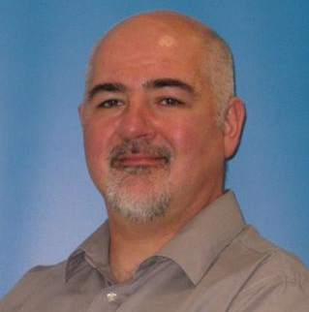
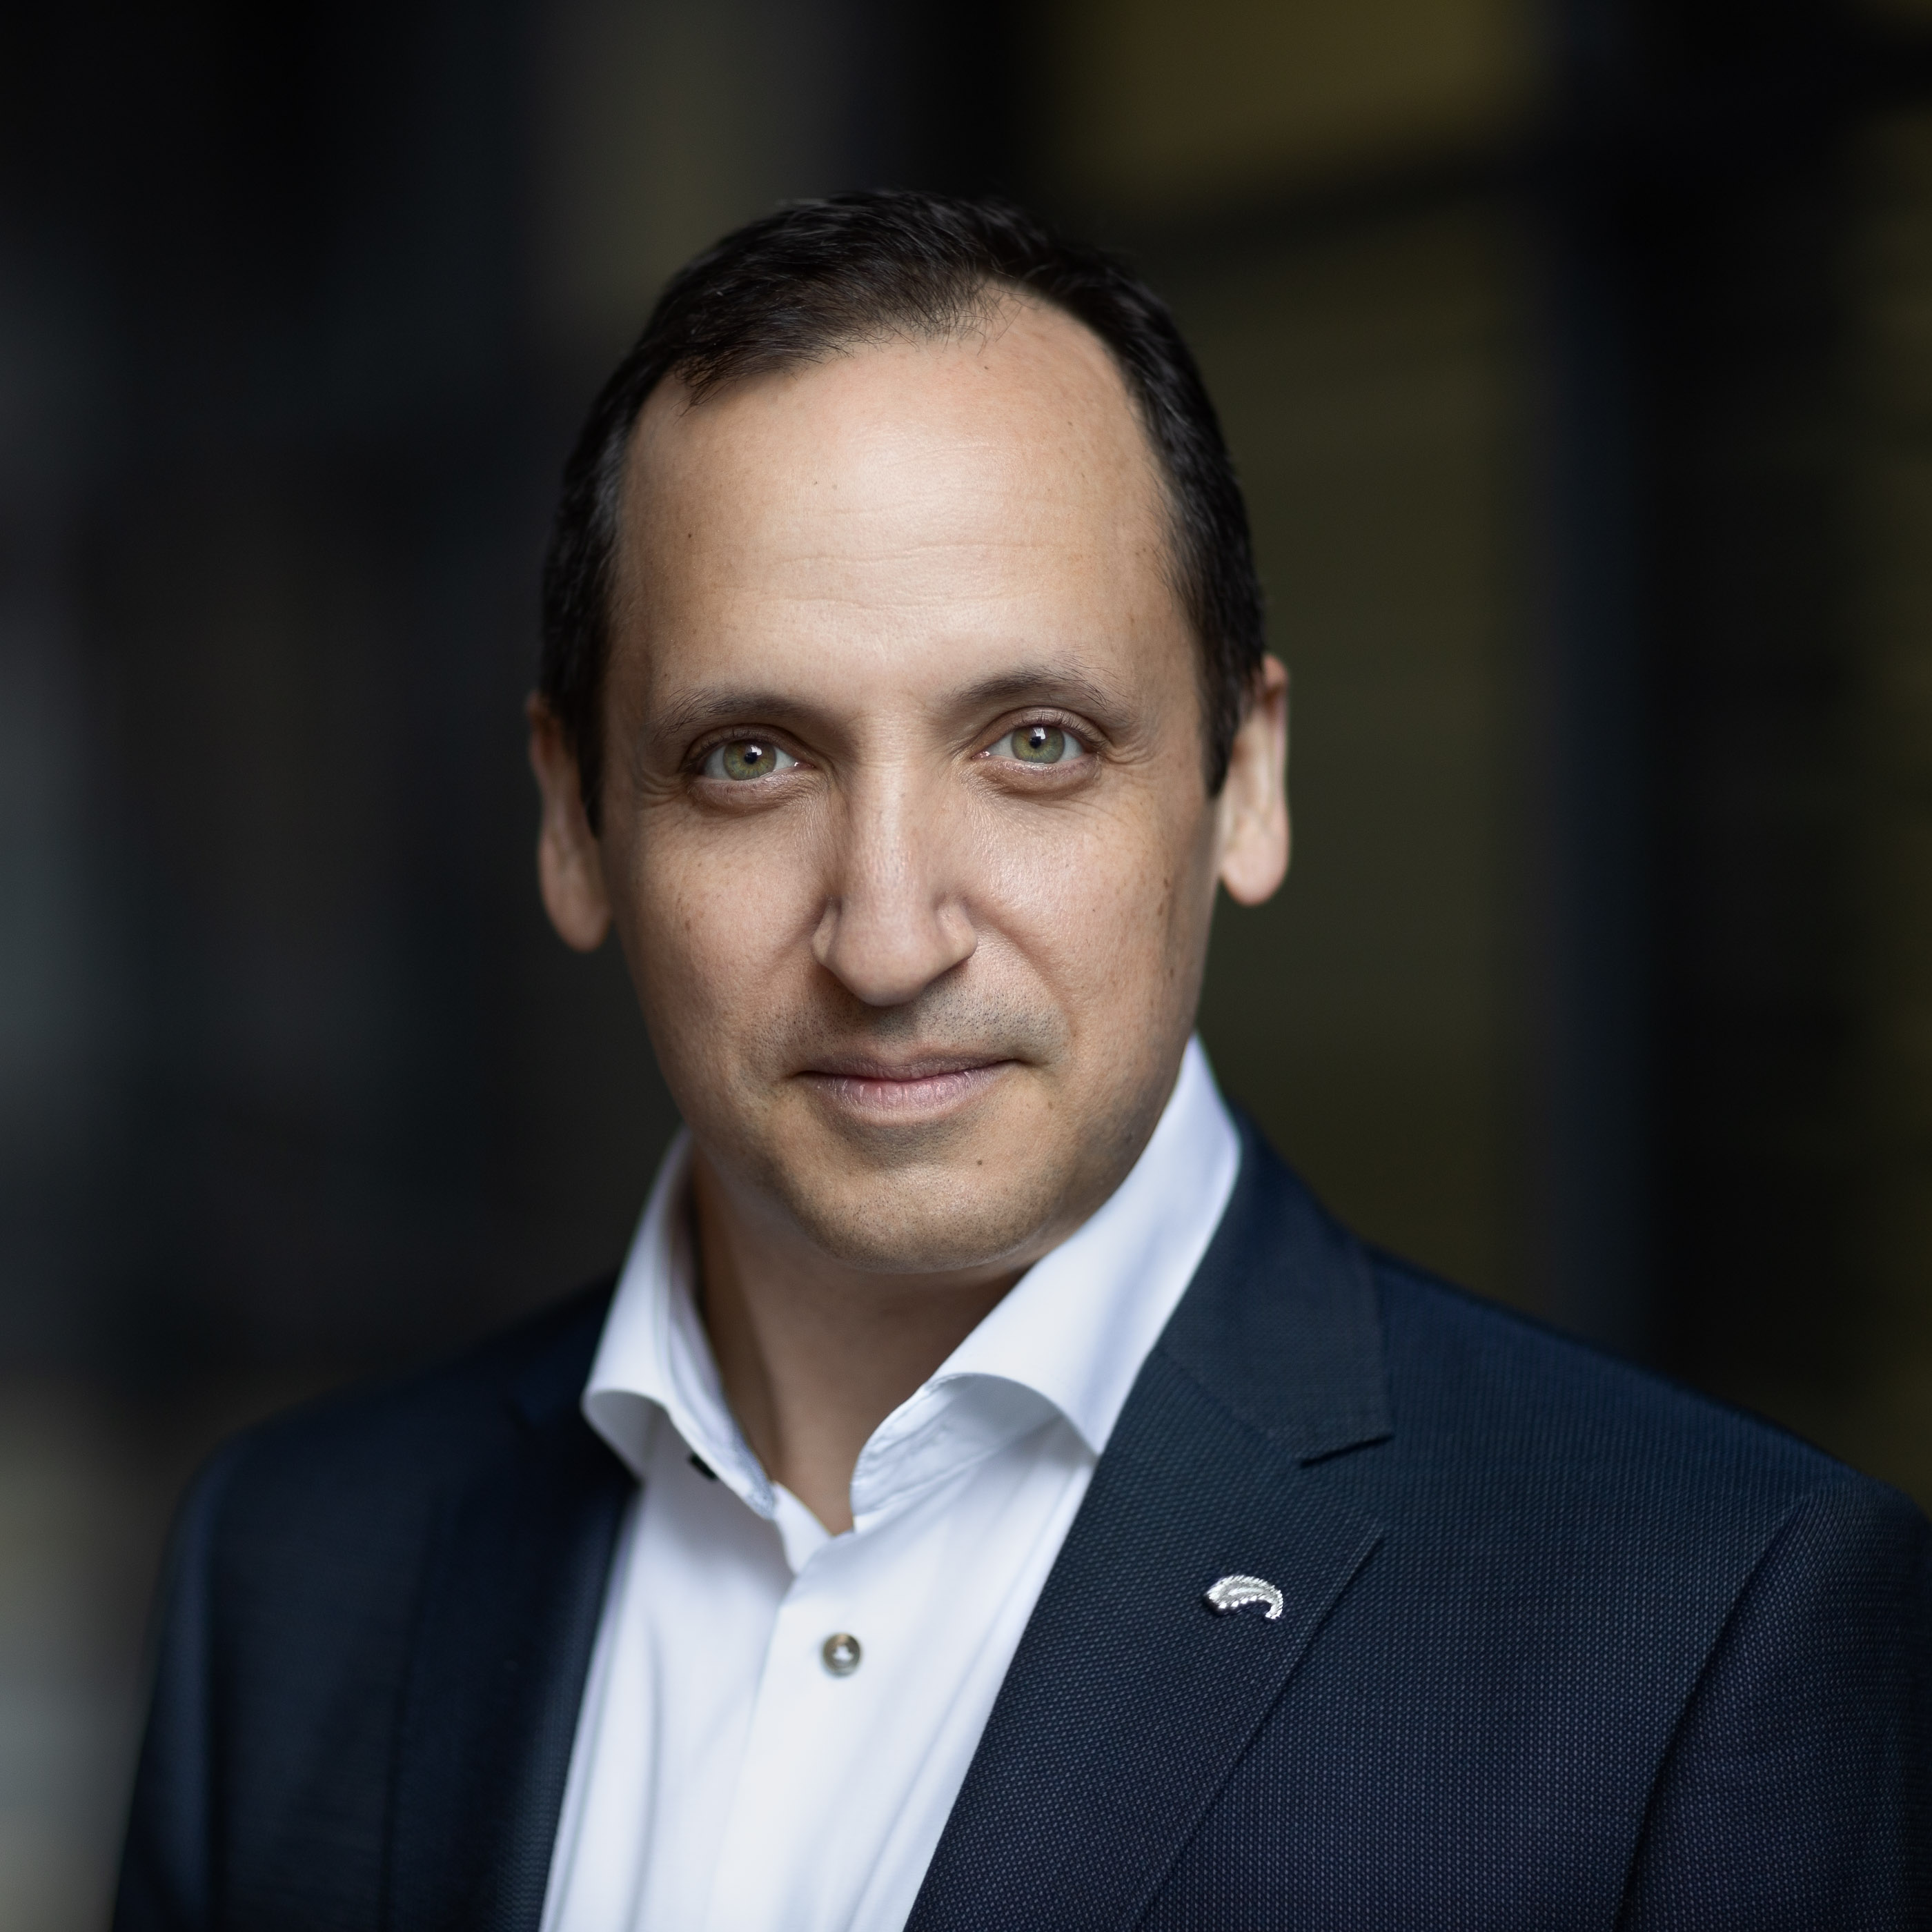
Scheduling & Dispatch Programme– Industry Outreach
Meet the Speakers
Brendan O’Sullivan
Future Markets
Brendan O’Sullivan has over 30 years’ experience in the Irish electricity sector and has specialised in wholesale power markets for the last 20 years.
He is a lead in the Future Markets Team and works on the Scheduling & Dispatch Programme.
Severin Garanzuay
External Advisor
Seve Garanzuay has 20+ years of experience in power markets and has worked in the all-island electricity market since 2014 since the I-SEM Programme.
His experience in utilities and power markets covers N. America, Australia, Europe, and the Middle East.
He is an external advisor to EirGrid/SONI for the Scheduling & Dispatch Programme.

Slide 4
Scheduling & Dispatch Programme– Industry Outreach
Why Are We Here?
Inform
We are here is to provide information about the ongoing work with the SDP initiatives and the impact on the market participant community. We will provide a view of the programme’s drivers, scope & objectives, structure, timelines, solution approach, and stakeholder engagement.
Discuss
We will discuss the functional approach – the key principles, look at the functional changes, and how this impacts you and your portfolio. We will field all questions – and we may not be able to answer all of them today.
Listen
We are here to listen. What are you thoughts on the SDP, the functional approach, and the impacts to your business? What questions do you need answers to? What clarity do you need?
Ask
We will ask for your participation throughout – we are better together.

Slide 5
Scheduling & Dispatch Programme – Industry Outreach
Setting Expectations
Meeting Rules
Engage: actively listen and ask questions. This session is for you.
Show Courtesy: allow everyone the time and space to participate in the discussion. Don’t talk over another speaker.
Scope Discipline: maintain focus on SDP. No specific technology discussion today.
SDP Technology
We are intentionally not discussing technology systems today.
There is ongoing work to develop the Solution Pathways and determine the optimal solution and delivery methods.
Notes on SDP’s Future
No SDP initiative has been approved beyond the current analysis phase.
We will keep the community up-to-date as the SDP status changes and more phases are approved for delivery.

Slide 6
Scheduling & Dispatch Programme – Industry Outreach
This workshop in context
Shaping Our Electricity Future
As a continuation of SDP bilateral meetings
FASS
MSDP
Others
Others
Others
SDP
MODS
Others
Focusing on the functional approach.
SDP
Aligned with other SOEF Programmes and SEMO meetings
Functional
Technical
Prog Mgmt
Rules, Codes
Stakeholder Forums
Scope

Slide 7
Scheduling & Dispatch Programme – Industry Outreach
Agenda
10:30 – 10:45
Introduction
10:45 – 12:30
SDP Initiatives, Part 1
SDP Overview
Evolution of SDP
Non-Priority Dispatch Renewables
Wind Dispatch Improvements
SDP Initiatives Part 1
12:30 – 1:00
Lunch Break
1:00 – 2:30
SDP Initiatives, Part 2
2:30 – 3:00
Closing

Slide 8
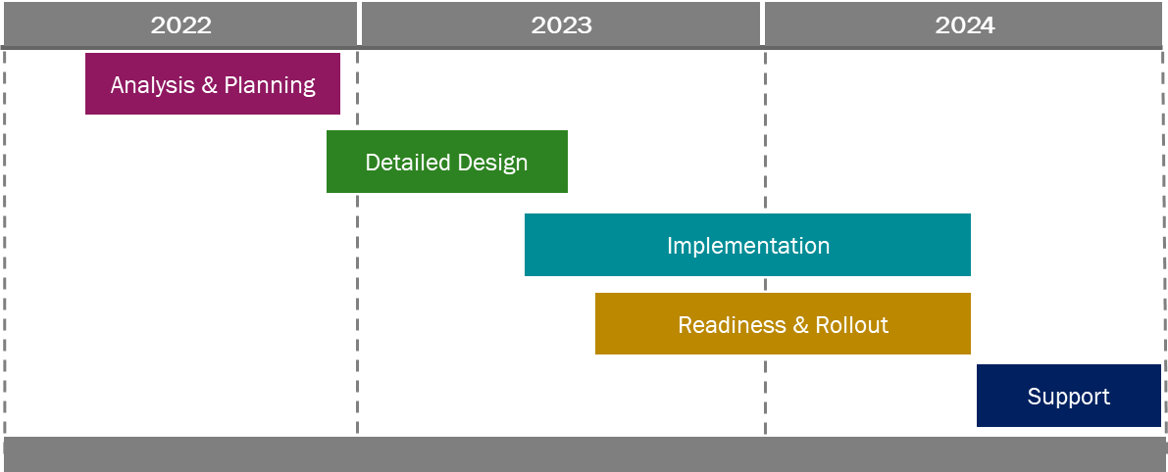
Scheduling & Dispatch Programme – Industry Outreach
Why Are We Here :: Inform
SDP Objective & Drivers
Scope of SDP
SDP Solution Approach
To enhance and improve the technology and capability of scheduling and dispatch in Ireland to meet some of the EU Clean Energy Package mandates and support the broader goals of renewables and SNSP penetration targets.
Clean Energy Package requirements
Ireland and Northern Ireland Government renewables targets for the 80%/70% total renewable energy and 95+% system non-synchronous penetration (SNSP) on an instantaneous basis.
One component of the broader SOEF programme.
Operation of non-priority dispatch of renewables
Energy Storage Power Station (ESPS) integration
Fast Frequency Response (FFR)
Wind dispatchability improvements
Reserve services scheduling and dispatch
Synchronous condenser scheduling and dispatch
To enhance and improve the technology and capability of scheduling and dispatch in the SEM to meet some of the EU Clean Energy Package mandates and support the broader goals of renewables and SNSP penetration targets.
Be pragmatic about solution pathways.
Solve the immediate and urgent problems at hand. Don’t use the SDP to fulfill a wish list.
Be an honest broker. Don’t allow perfect to be the enemy of good.
Communicate early and often – to all stakeholders. Bring them along the journey.
Maintain support of industry. Participant and industry support for and adoption of the SDP initiatives is critical.
Actively manage delivery partners. Clearly set expectations and demand excellence in delivery schedule and quality. Work collaboratively.
Achievable – Valuable – “Simple”
SDP Timelines
Industry Engagement
Bilateral outreach
Industry workshops
Ongoing user groups (TBC) as part of broader SOEF – and will be optimized with other programmes (FASS, et al.)
Communicate early – and often.

Slide 9
Scheduling & Dispatch Programme – Industry Outreach
Evolution of the SDP
2019
2020
2021
2022
Clean Energy Package
SEMC 20-028
SEMC 21-026 & 21-027
SEMC 22-009
Wide ranging regulation covering many complex issues with respect to system and market operations;
Article 12 removes priority dispatch from new renewable and HECHP generation > 400kW connecting after July 2019;
Article 13 addresses compensation
Covers Articles 12 & 13 with key focus on -
Eligibility for priority dispatch going forward;
Operation of non-priority dispatch renewables;
Compensation requirements for dispatch down;
SEM-21-026 – a further consultation on CEP, on market and non-market based redispatch and levels of compensation;
SEM-21-027 – a proposed decision on treatment of new renewables in the SEM;
the TSOs and SEMO host one or more workshops;
a TSO/SEMO paper within three months of Decision Paper;
Provided decisions on market and non-market based redispatch;
Set out proposals for treatment under enduring implementation while still supporting proposals set out in SEM-21-027 (including development of interim options);
Regulation
Industry workshops conducted in January and June 2020.
Workshop held in July 2021, setting out the issues to be developed, including the proposal to deliver the solution as part of the Scheduling & Dispatch package
Bilateral outreach to industry starting August 2022
Industry-wide workshop on approach in November 2022
Stakeholder
Engagement
Initial analysis for meeting 20-028
Planning for scheduling & dispatch programme
SDP launched
Started analysis of requirements to develop interim options;
Treatment of variable non-priority dispatch generation developed in this context;
Scheduling & Dispatch Programme

Slide 10
Scheduling & Dispatch Programme
SDP001
Treatment of variable Non-Priority Dispatch Renewables
Goal
To facilitate the treatment of variable non-priority dispatch renewables in the scheduling & dispatch processes, as guided by portions of the Clean Energy Package Article 12 and subsequent SEMC consultations and decisions.
What Changes?
TSO (Market / NCC)
More options in balancing market, greater cost-reflectivity in dispatch decisions for all units
More DIs (set points to NPDRs)
NPDRs
Submit COD and TOD
New charge code in SEM settlements: CUNIMB (Uninstructed Imb. Chg.)
Economic scheduling & dispatch (based on COD, TOD)
Dispatch instructions (set points)
Approach
NPDRs will submit data like conventional generators:
Energy
Reserves
NPDRs will be treated like competitive, conventional generators in the balancing market scheduling and dispatch, balancing market price formation, and SEM settlements.
Provide a means for NPDRs to submit COD/TOD.
Provide a means for the NCC to schedule and dispatch based on economics and physical constraints.
Allows participant to react to negative imbalance prices .
Non-market based redispatch (constraint and curtailment) will be pro-rated across all variable renewables regardless of priority dispatch status
In context of the market time horizon
Ex-Ante
Balancing
Redispatch
Settlement
EA position
Subject to balancing actions based on economics and system needs
LOCL and CURL are performed pro-rata across entire renewables portfolio (PD and NPDR)
CUMINB charge is now applicable
Ex Ante
BM: B&O
Scheduling
Dispatch
Settlement
None
Minor
Moderate
Major
Minor

Slide 11
Scheduling & Dispatch Programme
SDP004
Wind Dispatchability Improvements
Goal
To improve the NCCs renewables dispatch capability, allowing for more rapid and precise rebalancing of renewables based on changing conditions.
What Changes?
Market / NCC
More capability to react to changing network conditions
Better use of renewables across the network
Improved situational awareness of renewables Dis and system conditions
More efficient formulation and issuance of dispatch instructions
,
Generator Units
More frequent dispatch instructions, constraint/curtailment instructions.
Improved outcomes– constraints/curtailments are more efficient, being “lifted” earlier
Improved operational impact of dispatch instructions (easing)
Approach
More frequent re-balancing of curtailment and constraint, based on latest availability for units. This includes dynamic calculation of jurisdictional ratios.
Introduce greater visibility of wind dispatch instructions, decision support views, and monitoring of conditions.
Allow for the use of “advisory re-balancing” for control centre operators. This includes the visualisation of line overloads and ensuring their impacts are understood.
Allow for the gradual application of re-balancing, which will limit the overall impact to wind dispatch instructions
Allow for the automated batching/grouping of dispatch instructions as they are produced.
Ex Ante
BM: B&O
Scheduling
Dispatch
Settlement
None
None
None
Major
None

Slide 12
Scheduling & Dispatch Programme – Industry Outreach
Agenda
10:30 – 10:45
Introduction
10:45 – 12:30
SDP Initiatives, Part 1
12:30 – 1:00
Lunch Break
1:00 – 2:30
SDP Initiatives, Part 2
ESPS Integration
Synchronous Condensers
FFR in Scheduling & Dispatch
Reserves Scheduling & Dispatch
SDP Initiatives, Part 2
2:30 – 3:00
Closing

Slide 13
Scheduling & Dispatch Programme
SDP002
Energy Storage Power Station (ESPS) Integration
Current Challenges
Manual scheduling and dispatch of assets (batteries) in LTS, RTC, RTD
Unable to realise maximum value of battery storage in the S&D processes
Lack of visibility into aggregate availability of batteries available for S&D
Uncertainty on near- and long-term treatment of ESPS (batteries) in SEM and via NCC Operators.
Asset (battery) value at risk due to uncertainty around ESPS treatment, especially the coordination/interaction between markets (Bal, Cap, Ex Ante, DS3)
Lack of control over asset (battery) self-scheduling to support arbitrage opportunities
TSO
MPs
Proposed Approach
Stakeholder Feedback
Provide means for MPs to describe TOD/COD about battery assets
Provide means for MPs to self-schedule their batteries (Follow-PN approach)
Allow NCC Operators ability to incorporate batteries into LTS, RTC, RTD
Allow NCC Operators flexibility to deviate from PN in Balancing Market timeline
Overwhelmingly positive from industry groups and market participants
Aligns with discussions between industry and TSO
Aligns with near-term measures for Winter 2022/2023
Provides meaningful control over asset to facilitate Bal Mkt participation
SDP (ESPS) In Context
There has been some ambiguity caused by the language used in the multiple messaging points between EirGrid/SONI and the industry stakeholders. The timeline below is intended to clarify the various ESPS initiatives in a broader context and agree a naming convention.
Near-Term Measures
(Winer 2022/2023)
SDP “Solution”
Future (Potential) “Solution”
SEM 4.0
Near-Term measures to support the NCC for including batteries in scheduling & dispatch. Known limitation – no ability to s/d for charging (negative MW).
The solution for ESPS (batteries) to allow MPs and NCC to realise the benefits of battery storage. MPs have control over self-scheduling whilst the NCC retains the ability to dispatch off PN in the Bal Mkt. Allows for negative PNs and DIs.
The solution for ESPS (batteries) to allow MPs and NCC to realise the benefits of battery storage. MPs have control over self-scheduling whilst the NCC retains the ability to dispatch off PN in the Bal Mkt with full optimization in balancing.

Slide 14
Scheduling & Dispatch Programme
SDP002
Energy Storage Power Station (ESPS) Integration
Goal
To increase the use of ESPS (batteries) in scheduling & dispatch. Incorporating ESPS into the energy and reserve co-optimization routines, allowing the market participant and the NCCs to realise more value from the batteries.
What Changes?
Market / NCC
Better use of battery MW across the network
,
ESPS
More control over schedule(PN)
Responsible for managing storage level and boundaries/limits through ex-ante trading
Approach
Provide a means for the NCCs to include the battery assets in the scheduling & dispatch routines.
Provide a means for the MP to define a Physical Notification(PN) that the NCCs will follow (except in cases where system security is at risk).
Allow for the use of Negative PNs, so the CHARING and DISCHARGING schedule can be adequately described.
Include the ESPS in balancing market price formation.
Maintain the trickle charge option for batteries.
Ex Ante
BM: B&O
Scheduling
Dispatch
Settlement
None
Minor
Moderate
Moderate
Minor

Slide 15
Scheduling & Dispatch Programme
SDP003, SDP005
FFR and Reserves Scheduling & Dispatch
Goal
To increase the number of generation units offering reserve services to the market. To improve the accuracy and quality of reserve scheduling based on the most recent service availability data from the market participants.
What Changes?
Market / NCC
Better reserves scheduling and dispatch decisions using the most up-to-date service availability data.
Improved real-time situational awareness reporting on the availability of reserve-capable (including FFR) units for the scheduling and dispatch activities
,
Market Participants
Increased capability to submit real-time availability data
Improved outcomes for reserve allocation of generation units
Approach
Model, optimise, schedule, dispatch, and report on reserve services for all reserve-capable units in the scheduling and dispatch processes
Introduce the ability to use more frequent service availability data when performing S&D in CC.
Maintain existing reserves settlement processes
Ex Ante
BM: B&O
Scheduling
Dispatch
Settlement
None
Minor
Minor
Minor
None

Slide 16
Scheduling & Dispatch Programme
SDP006
Synchronous Condenser Scheduling & Dispatch
Goal
To provide for the consistent, reliable, and optimal scheduling and dispatch of synchronous condenser units. To realise the value of the services provided by the synchronous condenser units. To facilitate the agreed market settlements for synchronous condensers.
What Changes?
TSO (Market / NCC)
Effective and efficient inclusion of synchronous condenser units in scheduling and dispatch processes.
Improved real-time situational awareness reporting on the availability of synchronous condenser units available for the scheduling and dispatch activities.
,
Market Participants
Increased capability to submit commercial and technical offer data.
Effective utilization of services provided by synchronous condenser units.
Appropriate remuneration for certain costs (e.g., consumption, startup, no load).
Approach
Ability to schedule and dispatch synchronous condenser units to meet inertia requirement.
Provide for synchronous condenser units in registration, COD/TOD data management, reserve declarations, and market reporting.
Incorporate the new (planned and future) updates to the TSC(Trading and Settlement Code) for synchronous condenser units.
MOD_13_19 (existing modification in progress – shown here as it impacts solution)
Recovery of Startup, No Load costs
Ex Ante
BM: B&O
Scheduling
Dispatch
Settlement
None
Minor
Moderate
Moderate
Moderate

Slide 17
Scheduling & Dispatch Programme – Industry Outreach
Agenda
10:30 – 10:45
Introduction
10:45 – 12:30
SDP Initiatives, Part 1
12:30 – 1:00
Lunch Break
1:00 – 2:30
SDP Initiatives, Part 2
Closing Thoughts
Next Steps
Contacting Us
2:30 – 3:00
Closing
Closing

Slide 18
Scheduling & Dispatch Programme – Industry Outreach
Closing Thoughts and Next Steps
Stakeholder Engagement
Stakeholder Engagement will continue. We will host more industry-wide workshops and focused sessions for different groups (technical, programme management).
Engagement is bi-directional. We need to hear from you! You will hear from us.
Next Steps
Please provide feedback when you have reviewed and considered the information from today’s discussion.
Follow-up from any “Listen” item discussed today.

Slide 19
Scheduling & Dispatch Programme – Industry Outreach
Following up with the SDP
To raise an issue or query for the Scheduling & Dispatch Programme:
Contact
SDP Queries
info@sem-o.com
Operating Hours
9:00am - 5:00pm IPT (Mon-Fri)
Queries received outside of operating hours will be addressed the next business day.
Information to Provide
Your Name
Your email & phone number
Your organisation
Topic of Issue/Query
Description of the issue or query
Any additional information to aid in understanding the issue or query

Slide 20
Scheduling & Dispatch Programme – Industry Outreach
Evolution of the SDP
2019 - Clean Energy Package
Clean Energy Package published by EU in June 2019;
Wide ranging regulation covering many complex issues with respect to system and market operations;
Article 12 removes priority dispatch from new renewable and HECHP generation above 400kW connecting after July 2019;
Existing renewable and HECHP generation could lose their priority dispatch status where there was a significant change to their installation;
Existing renewable and HECHP generation could also chose to forego priority dispatch for their own reasons;
2020 – Workshops and
SEM-20-028
Industry workshop held in January 2020 to discuss the issues relating to CEP requirements;
SEM RAs issued SEM-20-028 in April 2020 covering both Articles 12 & 13 with key focus on -
Eligibility for priority dispatch going forward;
Operation of non-priority dispatch renewables;
Compensation requirements for dispatch down;
Second workshop held with industry in June 2020 while RA consultation was underway;
Considered that large system changes would be needed to facilitate what some of the solutions being discussed;
2021 –
SEM-21-026 and
SEM-21-027
Two major SEMC papers in April 2021
SEM-21-026 – a further consultation in relation to CEP, on interpretation of market and non-market based redispatch and levels of compensation;
SEM-21-027 – a proposed decision on treatment of new renewables in the SEM;
the TSOs and SEMO host one or more workshops;
a paper to be prepared by the TSOs and SEMO within three months of publication of the Decision Paper;
Workshop held in July 2021, setting out the issues to be developed, including the proposal to deliver the solution as part of the Scheduling & Dispatch package
2022 –
SEM-22-009 and
the Scheduling & Dispatch Programme
After publication of SEM-21-027, the TSOs and SEMO began analysis of requirements to develop interim options;
Work on enduring implementation still to be considered;
Options for treatment of variable non-priority dispatch generation developed in this context;
SEM-22-009 published, providing decisions on market and non-market based redispatch;
Sets out proposals for treatment under enduring implementation while still supporting proposals set out in SEM-21-027 (including development of interim options);
After considerable analysis work by TSOs and SEMO, bilateral outreach started in August 2022

