Slide 1
EirGrid Celtic Interconnector Community Forum Meeting
6th December 2022

Slide 2
Welcome & Introductions

Slide 3
Minutes from 29th September meeting proposed for sign off

Slide 4
Recap on the year’s activity

Slide 5
Update on project progress

Slide 6
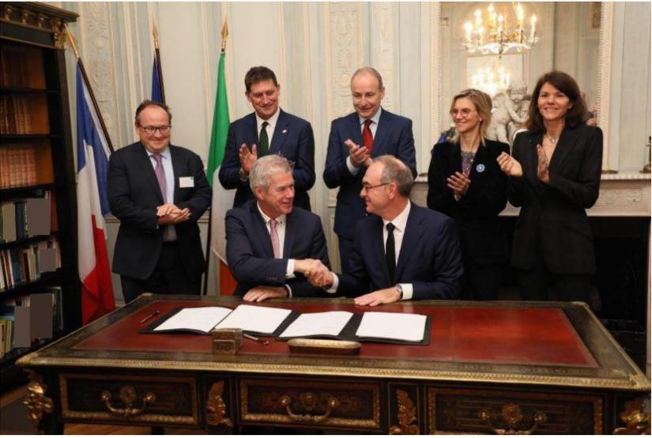
Contract Signature 25 November 2022
“We already have a Joint Plan of Action between our two Governments which identifies how we can deepen our cooperation in areas such as offshore wind, the development of renewable energies, and the development of smart and sustainable cities.
There is much that we can learn together – how to protect our coastlines, how to engage with local communities and fisherman, and how to reinvigorate economic development in coastal communities.”

Slide 7
Project Schedule
Phase Description
Feasibility
Initial Design & Pre-Consultation
Detailed Design
& Consents
Preliminary
Feasibility
Construction
Timetable
2011 - 2014
2014 - 2016
2016 - 2019
2020 – 2022
2022 – 2026
EirGrid / RTE Project Work
Streams
Benefits
Technology
Costs
Marine survey
Project Parameters
Economic & Financial Analysis
Initial Design
Pre-Consultation
Investment Request
Grant Application
Detailed Design
EPC Procurement
Consenting
Contract Award
Manufacturing
Energisation
Status
Complete
Complete
Complete
Complete
Commenced
Notes:
September key date – when Final Investment Decision is due to be made. Will be a major milestone for the project partners.

Slide 8
EPC Contractors
2023
Ballyadam Converter Station (Ireland)
SAC Cable Sealing End Compound
Ar Merzher Converter Station (France)
HVDC submarine cable (497 km)
HVDC land cable (France)
HVDC land cable (Ireland)
HVAC land cable (Ireland)
Fibre Optic cable (repeated system)
Appointment of main contractors
Appointment of sub contractors
Notes:
Process -

Slide 9
Construction Phase – Preliminary Schedule
2023
2024
2025
2026
Design (Cable and Converter Station)
Manufacturing of Irish AC cable
Trenching and ducting of land DC cables and land HVAC cables in Ireland.
Converter station civil works commencement
Commence manufacturing of offshore cable
Installation and jointing of AC and DC land cables
Converter station installations progress
Offshore maritime installation campaign 1 & 2
Submarine cable protection campaigns 1 & 2
Offshore marine installation campaigns 3 & 4
Submarine cable protection campaigns 3 & 4
Commissioning
tests
Interconnector system tests
Trial Operation period commences
Continuous engagement with all stakeholders

Slide 10
Next Steps
Next Phase
Build
Cable Installation
Operational Readiness
Commission
Q1 2023
Main and sub contractor appointments for land cable work
Completion of community benefit strategy
Construction programme development.

Slide 11
Questions on project progress

Slide 12
Update on Community Benefit Progress

Slide 13
Strategy Community Consultation – Update
Survey launched 23rd November 2022
Open for submissions until 20th December 2022
Over 140 submissions on the online survey @ 6th December 2022
Approximately one third of responses are voluntary/community/ school/stakeholder submissions
Approximately two thirds of responses are individual resident submissions

Slide 14
Strategy Community Consultation – Activity to Date
Online Survey issued:
- Via Forum members
- Via PPN
- Via email to SECAD community contacts
- Via SECAD social media
- To local public representatives, Municipal Officers and senior Local Authority staff
- To primary and secondary schools
- 6 x drop-in sessions conducted
- To SEAI

Slide 15
Strategy Community Consultation – Further Actions
Between 06.12.22 – 20.12.22:
Press release
On-line information session Tuesday, 13th December @ 7pm
Dedicated SECAD webpage
Forum member support
On-going social media campaign
Issue reminders of closing date

Slide 16
AOB

Slide 17
Meeting Dates for 2023

