Slide 1
EirGrid Energy Citizens Roadshow 2022
Welcome.
Please take time to network, explore the information stands and help yourself to refreshments.
The panel discussion will commence at 7pm.

Slide 2
EirGrid Energy Citizens Roadshow 2022
Open and Welcome
Sinead Dooley, Head of Public Engagement, Eirgrid

Slide 3
EirGrid Energy Citizens Roadshow 2022
Overview of this evening
Claire Ronan

Slide 4
EirGrid Energy Citizens Roadshow 2022
6.30pm Sign In, Networking, Information Stalls and Refreshments.
7.00pm Open and Welcome
7.05pm Overview of Event and Introduction of the Panel
7.10pm What Shaping Our Electricity Future means for Sligo
7.25pm Renewable Energy – An Opportunity to Balance Development in Ireland
7.40pm SEAI Grants and Supports for Energy Upgrades
7.55pm National Network, Local Connections
8.10pm Questions and Answers
8.20pm Close

Slide 5
EirGrid Energy Citizens Roadshow 2022
What Shaping Our Electricity Future means for Sligo
Derek Carroll, Network Design Manager, EirGrid

Slide 15
EirGrid Energy Citizens Roadshow 2022
Renewable Energy – An Opportunity to Balance Development in Ireland
Roger Sweetman, Head of Sustainable Enterprise, Western Development Commission

Slide 23
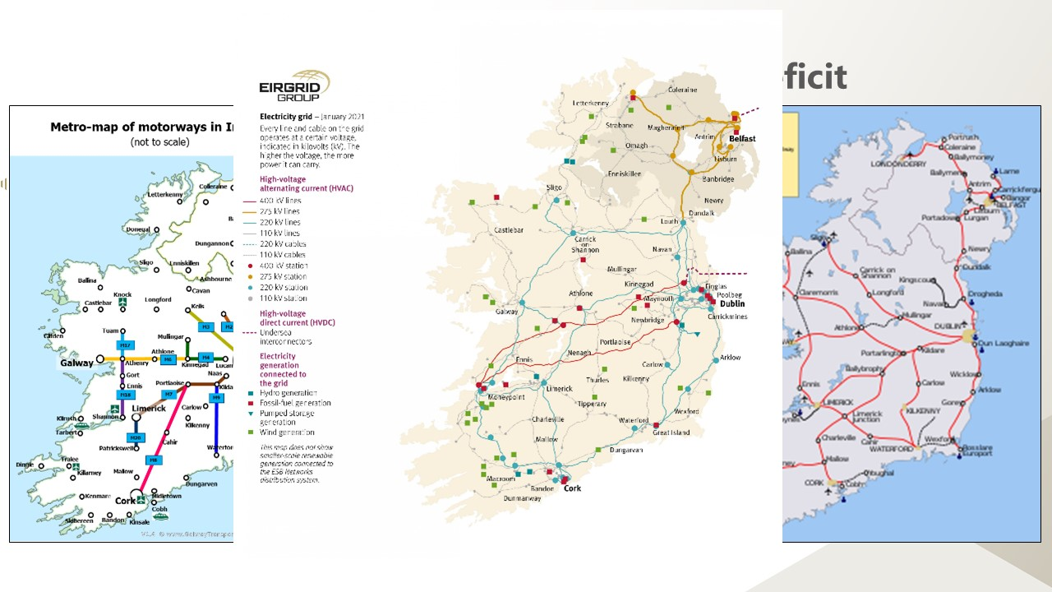

Slide 28
EirGrid Energy Citizens Roadshow 2022
SEAI Grants and Supports for Energy Upgrades
John Flynn, Programme Manager SEAI

Slide 41
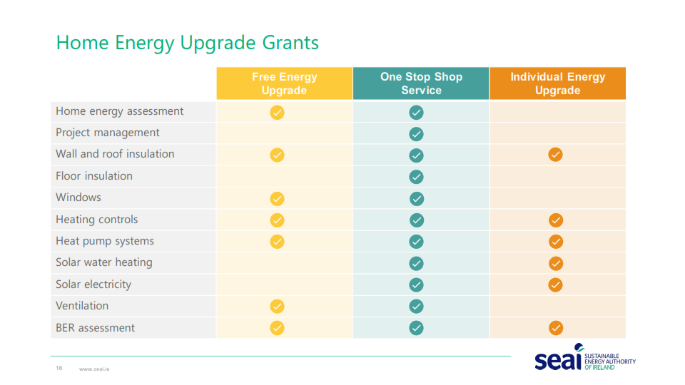

Slide 49
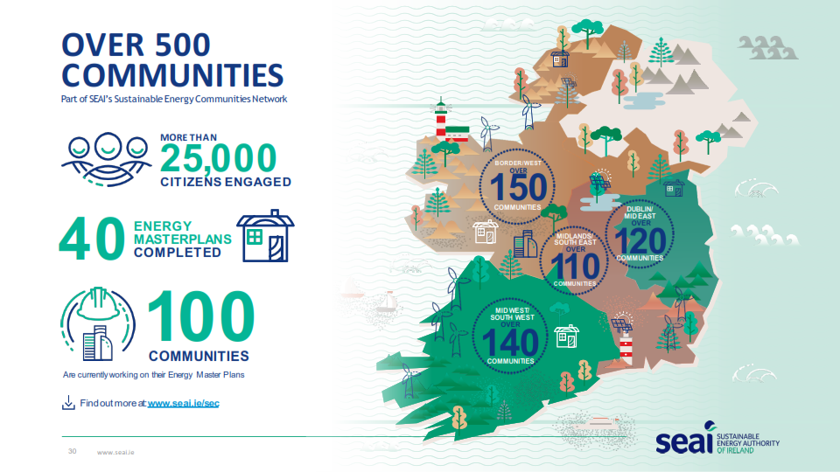

Slide 67
EirGrid Energy Citizens Roadshow 2022
National Network, Local Connections
Ellen Diskin, Head of National Network, Local Connections, ESB Networks

Slide 74
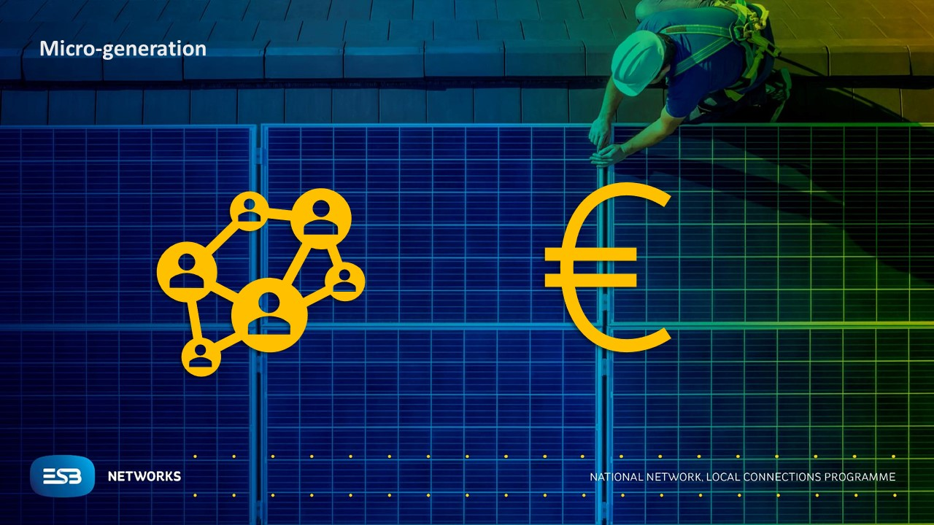

Slide 75
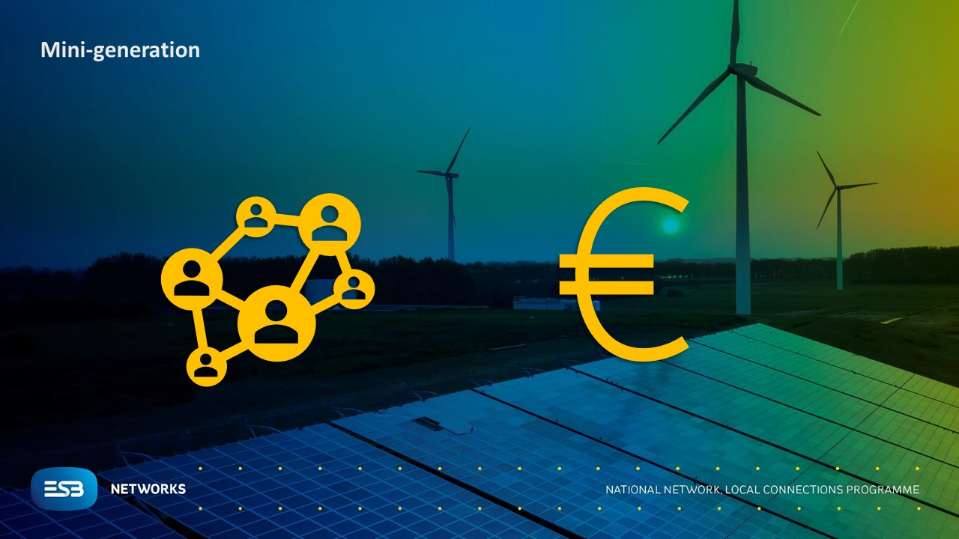

Slide 81
EirGrid Energy Citizens Roadshow 2022
Questions and Answers Session

