Slide 1
Network Code LFC&R
Reserve Provision – TSO-Perspective

Slide 2
Article 16: Load-Frequency-Control Structure
Process Responsibility
Structure
TSOs shall take over the responsibility to cope with power imbalances in order to achieve frequency quality
Cooperation is a necessary precondition
Process Activation Structure
The TSOs shall control (trigger) reserve activation according to the technical standards of the NC, through
operation of technical LFC processes

Slide 3
Article 18: Areas in LFC&R NC
Synchronous Area
Frequency Quality Target, FCR Dimensioning
LFC Block
Frequency Restoration Quality Target & FRR/RR Dimensioning
LFC Area
Frequency Restoration Control Error,
Frequency Restoration and Replacement Processes
Monitoring Area
Online Monitoring of the Power Interchange
Market Balance Area
Scheduling

Slide 4
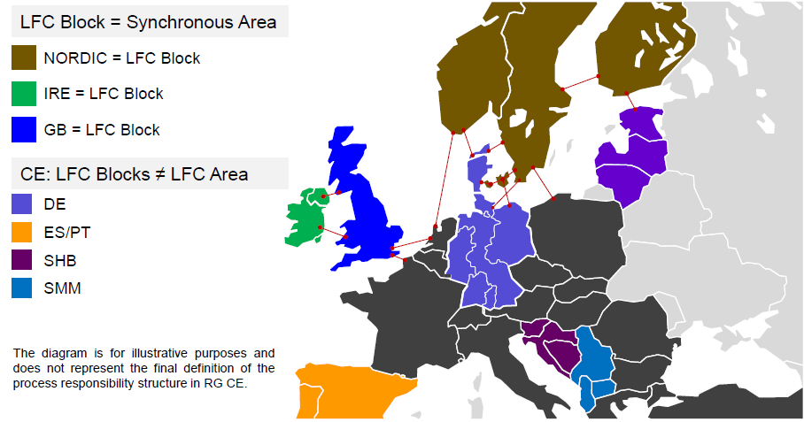
Example

Slide 5
Articles 19-21: FCP, FRP and RRP – Example 1
Frequency Containment
Reserves
Frequency Restoration
Reserves
Replacement
Reserves
Stabilization
Control to Set-Point
Release Used FRR
Reserves/
Frequency
FCP
FRP
FCR
FRR
RR
automated
manual
RRP
t
Time to Restore Frequency

Slide 6
Articles 19-21: FCP, FRP and RRP – Example 2
Frequency Containment
Reserves
Frequency Restoration
Reserves
Replacement
Reserves
Stabilization
Control to Set-Point
Release Used FCR & FRR
Reserves/
Frequency
FCP
FRP
FCR
FRR
RR
manual
RRP
t
Time to Restore Frequency

Slide 7
Dimensioning
FCR Dimensioning
Article 27
FCR Dimensioning for the whole Synchronous Area
FCR ≥ Reference Incident of the Synchronous Area
Additionally - probabilistic approach
FRR Dimensioning
Article 30
FRR Dimensioning for LFC Block
FRR ≥ Reference Incident of the LFC Block
Additionally - probabilistic approach
RR
Dimensioning
Article 33
RR Dimensioning for LFC Block
RR shall be “sufficient”

Slide 8
Articles 22-24: Coordination of Control
Imbalance Netting
Imbalances
No Netting
Imbalance Netting
Deficit
Surplus
Pos. FRR
Neg. FRR
100
-100
100
-100
100
-100
Cross-Border FRR/RR Activation
Imbalances
No Cross-Border
Cross-Border
Deficit
Pos. FRR
Pos. FRR
100
-100
100
-100
Coordination of control processes enables more cooperation!

Slide 9
Interdependencies
Real-Time Coordination of Control Processes
Market Design for FRR/RR
Imbalance Netting
enables
Common Merit Order for Reserve Activation
enables
Cross-Border FRR/RR Activation
enables
Geographical Location and Availability of Reserves
!
Balancing NC!
Sharing
Exchange
enables
Coordination of Procurement

Slide 10
Network Code LFCR
Impact on
- Reserve Providers
- Reserve Providing Units
- Reserve Providing Groups

Slide 11
Terms Overview
PROVIDER
Entity operating a Reserve Providing Unit or
a Reserve Providing Group
Reserve Providing Group
Reserve Providing Unit
A conglomeration of generating and/or demand facilities that are located in the area of one single Reserve Connecting TSO together providing reserves of kind FCR, FRR or RR to a TSO and which together fulfil the requirements of the Reserve Connecting TSO;
A single generating or demand
facility providing reserves types
FCR, FRR or RR to a TSO and
fulfilling the operational
requirements of
the Reserve Connecting TSO

Slide 12
Prequalification for reserve provision
Entity operating a Reserve Providing Unit or
a Reserve Providing Group prequalifies to the
Reserve Connecting TSO
PROVIDER
Reserve Providing Group
Reserve Providing Unit
A Reserve Providing Unit or a Reserve Providing Group needs to be prequalified to verify compliance for the FCR, FRR or RR base response requirements set by the Network Code and additional local requirements if applicable.

Slide 13
FCR
Main Provider Related Aspects
in the Code Draft
Overview about Relation to Existing Rules
Aready
Applied
Already Partly
Applied
NEW

Slide 14
FCR
Technical Minimum Requirements to be ensured by the TSOs (Art. 28/1,2,5) → Requirements relevant for Providers
- Minimum accuracy for frequency measurement
- Minimum governor insensitivity
- Full Activation Time
- Full Activation Deviation
Additional requirements on SA basis possible (Art. 28/4)
Individual Requirements for Reserve Providing Groups (Art. 28/4)
by the Connecting TSO possible (for ensuring operational security)
already
applied
Already partly
applied

Slide 15
FCR
Requirement for a FCR Provider to ensure that monitoring of the FCR activation of the generating and/or demand facilities within a Reserve Providing Group is possible (Art. 28/4)
FCR Prequalification Process (Art. 28/4,5,6)
- To assess the fulfilment of the technical and availability requirements
- Process Management: Connecting TSO responsibility
FCR Activation proportional to frequency deviation (Art. 28/7)
  Relay activated FCR included
Data to be delivered by an FCR Provider (Art. 28/9)
status ON/OFF, time-stamped values of scheduled/instantaneous active power with/without FCR activation, droop;
on request of the TSO in real time

Slide 16
FCR
Continous Availability – exception: unplanned outage (Art. 29/4)
- limit for size of a single unit / single electrical node
- replacement within determined time (e.g. 12 hours for RG CE)
FCR Activation (Art. 29/6)
- unlimited capability → as long as Frequency deviation persists
- limited capability → as long as Frequency deviation persists
unless energy reservoir is exhausted
→ specification in prequalification process
→ minimum: 30 Minutes full activation
(see also NC RFG)
→ ensure appropriate measures for recovery within determined period of time (e.g. 2 hours in CE)

Slide 17
FRR
Technical Minimum Requirements (Art. 31/1)
- Automatic FRR: maximum activation delay: 30s
Data to be delivered by an FRR provider per unit (Art. 31/1)
- Activated FRR
- Reference power
Complementary Technical Requirements per LFC Block (Art. 31/2)
- FRR Full Activation Time (automatic/manual)
- Availability requirements
- Ramp rate
Complementary Techn. Requirements for Providers and Units
per Connecting TSO possible (Art. 31/2)

Slide 18
FRR
Requirements for Reserve Providing Groups (Art. 31/1)
per Connecting TSO possible (for ensuring operational security)
Requirement for a FRR Provider to ensure that monitoring of the FRR activation of the generating and/or demand facilities within a Reserve Providing Group is possible (Art. 31/1)
Data to be delivered by an FRR provider per generation or demand facility > 1 MW (Art. 31/1)
- Activated FRR
- Reference power
FRR Prequalification Process (Art. 31/3)
- To assess the fulfilment of the technical and availability requirements
- Process Management: Connecting TSO responsibility
  Activation Requirement (Art. 31/3) for Providers according to the
  request of the TSO

Slide 19
RR
Technical Minimum Requirements (per LFC Block - Art. 34/2)
- Connection to only one Connecting TSO
- Full Activation within RR Full Activation Time
- Real time measurements of reference power and activated RR
Requirements for Reserve Providing Groups (Art. 34/3)
per Connecting TSO possible (for ensuring operational security)
Requirement for a RR Provider to ensure that monitoring of the RR activation of the generating and/or demand facilities within a Reserve Providing Group is possible (Art. 34/3)
RR Prequalification Process (Art. 34/3,4)
- To assess the fulfilment of the technical and availability requirements
- Process Management: Connecting TSO responsibility
  Activation Requirement (Art. 34/3) for Providers according to the
  request of the TSO

Slide 20
Reserve Providing Units connected to DSO Grid
Prequalification Phase
Obligation to Reserve Providers to inform “connecting” DSO about:
  each Power Generating Module and/or Demand Unit;
  provided reserve type (FCR, FRR, RR);
  maximum Reserve Capacity provided by each Power Generation Module and/or Demand Unit; and
  maximum change of rate of active power for each Power Generation Module and/or Demand Unit
Right of the DSO to object or set limits to the delivery of Reserves based on security analysis
Operation Phase
Right of the DSO the request the same level of information as in the prequalification phase if needed for the secure grid operation

Slide 21
Network Code LFC&R
Exchange and sharing of reserves

Slide 22
Exchange and sharing of reserves
Sharing and exchange of reserves
  Role of NC LFC&R and EB NC
  Principles
Exchange of reserves
Sharing of reserves
XB activation process (for optimization purposes)

Slide 23
Scope NC LFC&R & EB NC
Technical
Market
NC LFC&R:
Determine required volumes and distribution of reserves to ensure operational security
Dimensioning of reserves
Technical limits for exchange, sharing and cross-border activation of reserves
Technical requirements to ensure safe exchange / sharing / cross-border activation of reserves
Need for available transmission capacity
Fall-back solutions,…
NC Electricity Balancing:
Provision of required reserve volumes (within the limits for distribution set by NC LFC&R)
Optimized activation of reserves (energy) available in the system
Mechanisms to ensure the available transmission capacity for sharing / exchange / XB activation of reserves

Slide 24
Exchange, sharing and cross-border activation
Exchange / sharing /cross-border activation of reserves (e.g. FRR)
Exchange of reserves
Sharing of reserves
XB activation of FRR (optimization!)
‘Area A’ receives of its FRR [MW] from ‘Area B’ to fulfil its FRR Dimensioning Reqs.
‘Area A’ uses part of the FRR [MW] of ‘Area B’ to fulfil FRR Dimensioning Reqs
‘Area A’ and ‘Area B’ optimize activation of their reserves in the system
Distribution & volumes of reserves [MW]
NC LFC&R sets technical limits and technical requirements
NC EB deals with reserve procurement and optimization,…
Activation of reserves [MWh]
NC LFC&R sets technical limits and technical requirements
NC EB deals with optimization of reserve activation,…

Slide 25
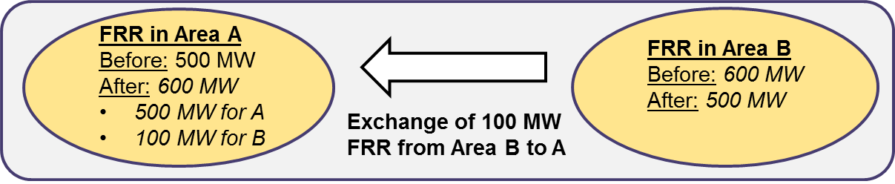
Exchange of reserves
Exchange of reserves impacts distribution but not the amount of reserves
Exclusive access to reserves in another ‘Area’. No other TSO relies on this reserves to meet its reserve requirements according to the dimensioning process.
Limits required to ensure even distribution of reserves for Operational Security
  Network splitting / unexpected congestion / failure of communication equipment,…
Transmission capacity must be available for the exchange of reserves.

Slide 26
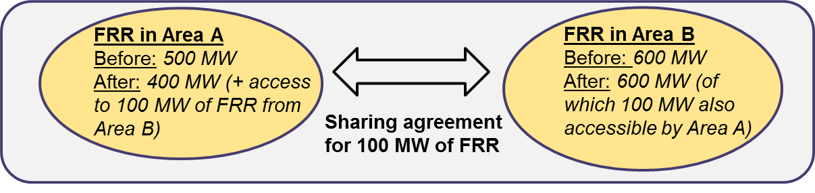
Sharing of reserves
Sharing of reserves impacts the amount of reserves (and also the distribution)
Non-exclusive access to reserves in another ‘Area’. More than 1 TSO relies on ‘shared’ reserves to meet reserve requirements according to dimensioning process.
Sharing only allowed if probability for simultaneous access of reserves is very low
  FRR reduction if: ‘FRR for Dimensioning incident’ > ‘FRR for other purposes’
  RR reduction if: probability of simultaneous activation is proven to be very low.
Maximum FRR reduction: limit for FRR reduction due to sharing with other ‘Areas’
Sharing can be unilateral or bilateral
Transmission capacity must be available to activate shared reserves

Slide 27
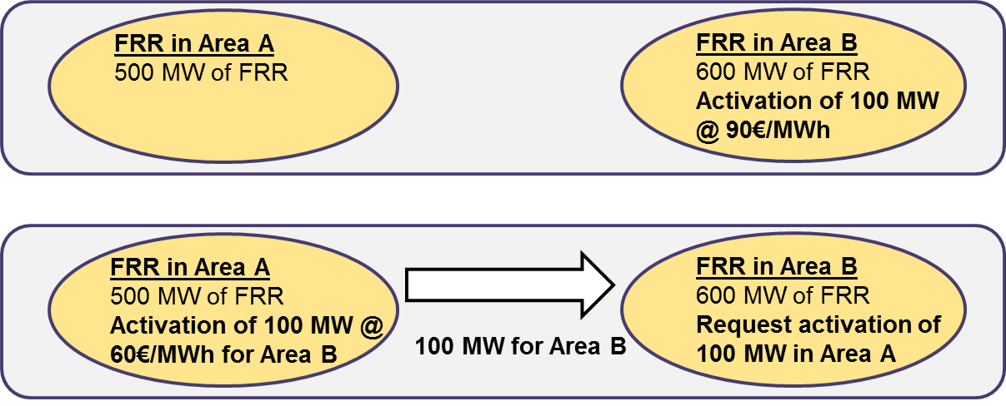
XB activation of reserves for optimization
XB activation process for optimization purposes is not related to exchange or sharing of reserves [MW].
Such a process aims to activate the available reserves in the system in a more optimal way (NC Balancing).

Slide 28
Network Code LFCR
Frequency Quality

Slide 29
Frequency Quality
Structure of the Frequency Quality chapter
Article 8 defines the process of frequency quality management
There are defining parameters and target parameters both for Frequency Quality and for Frequency Restoration Control Error (new wording for ACE).
Article 9 defines Frequency Quality Defining and Target Parameters for each Synchronous Area
Nominal Frequency
Standard Frequency Range
Max. Inst. Frequency Deviation
Max. Steady State Frequency Deviation
Time to Recover Frequency (GB and IRE only)
Frequency Range within Time to Recover Frequency (GB and IRE only)
Time to Restore Frequency (all SAs)
Frequency Range within Time to Restore Frequency (all SAs)
Frequency Quality Defining Parameters
Frequency Quality Target Parameters
Maximun number of minutes outside the Standard Frequency Range
15000 minutes/year is under consideration for most SAs

Slide 30
Frequency Quality Defining Parameters
Frequency Quality Defining Parameters
 | Baltic | CY | CE | GB | IRE | NE
Nominal Frequency | 50 Hz | 50 Hz | 50 Hz | 50 Hz | 50 Hz | 50 Hz
Standard Frequency Range | ±50 mHz | ±100 mHz | ±50 mHz | ±200 mHz | ±200 mHz | ±100 mHz
Maximum Instantaneous Frequency Deviation | 800 mHz | 1200 mHz | 800 mHz | 800 mHz | 1000 mHz | 800 mHz
Maximum Steady-state Frequency Deviation | 200 mHz | 500 mHz | 200 mHz | 500 mHz | 500 mHz | 500 mHz
Time to Recover Frequency | not used | not used | not used | 1 minute | 1 minute | not used
Frequency Range Within Time To Recover Frequency | not used | not used | not used | ±500 mHz | ±500 mHz | not used
Time To Restore Frequency | 15 minutes | 20 minutes | 15 minutes | 10 minutes | 20 minutes | 15 minutes
Frequency Range Within Time To Restore Frequency | not used | ±100 mHz | not applicable | ±200 mHz | ±200 mHz | ±100 mHz

Slide 31
Frequency Restoration Control Error
For the LFC Block
Article 10 defines Frequency Restoration Control Error Defining and Target Parameters for each Control Block
Frequency Restoration Control Error Defining Parameters
Level 1 Frequency Restoration Control Error Range
Level 2 Frequency Restoration Control Error Range
Frequency Restoration Control Error Target Parameters
Max. Nº of intervals outside Level 1 FRCER: <= 30%
Max. Nº of intervals outside Level 2 FRCER: <= 5%
Frequency Quality derives also from FRR as it is the reserve that would return the System Frequency to its Nominal Value. In SAs with more than one LFC Block, the desirable quality shall be translated to the quality of the Frequency Restoration Control Error and shared by the LFC Blocks.

Slide 32
Data Collection and Delivery Process
Article 11: Data needed to perform quality checks
Per each Synchronous Area:
Instantaneous Frequency Data
1-minute Average Frequency Data
1-minute Average Frequency Deviation Data
Per each LFC Block :
Instantaneous Frequency Restoration Control Error Data
1-minute Average Frequency Restoration Control Error Data Data
15 (20)-minute Average Frequency Restoration Control Error Data Data
All TSOs in a Synchronous Area will commonly define:
Measurement Period: shorter or equal to 1 second
Measurement Accuracy: 1 mHz for Frequency Measurements or 10 MW for FRCE measurements
Average calculation method
File formats and means of exchange

Slide 33
Article 12: Frequency Quality Evaluation Criteria
  For the Synchronous Area
    standard deviation of the 1-minute Average Frequency Data during a 3-month period for the Synchronous Area;
    absolute Frequency Deviation range corresponding to the 95-percentile of the 1-minute Average Frequency Data during a 3-month period for the Synchronous Area;
    total time during a 3-month period in which the instantaneous Frequency Deviation was greater than the Maximum Instantaneous Frequency Deviation;
    number of 1-minute Average Frequency Data values during a 3-month period outside the Standard Frequency Range;
Frequency Quality Evaluation Criteria iv to be compared to the Frequency Quality Target Parameter.

Slide 34
Article 12: Frequency Quality Evaluation Criteria
3 month data
-SFR
μ
SFR
-σ95
σ95
-σ
σ

Slide 35
Article 12: Frequency Quality Evaluation Criteria
  For the LFC Block
    average during a 3-month period of the values corresponding to the average within a time interval equal to Time To Restore Frequency of the FRCE of the LFC Block;
    standard deviation during a 3-month period of the values corresponding to the average within a time interval equal to Time To Restore Frequency of the FRCE of the LFC Block;
    absolute Frequency Restoration Control Error range corresponding to the 95-percentile of the values corresponding to the average within a time interval equal to Time To Restore Frequency of the FRCE of the LFC Block during a 3-month period;
    number of time intervals of a period equal to Time To Restore Frequency in which the average of the FRCE of the LFC Block is outside the Level 1 Frequency Restoration Control Error Range during a 3-month period;
    number of time intervals of a period equal to Time To Restore Frequency in which the average of the FRCE of the LFC Block is outside the Level 2 Frequency Restoration Control Error Range during a 3-month period;
    number of events for which after the occurrence of a FRCE of a LFC Block outside the Level 2 Frequency Restoration Control Error Range the FRCE of the LFC Block is not returned to 10% of the Level 2 Frequency Restoration Control Error Range within the Time to Restore Frequency during a 3-month period;
Frequency Quality Evaluation Criteria iv and v are to be compared to the FRCE Target Parameters.

Slide 36
Article 12: Frequency Quality Evaluation Criteria

Slide 37
Synchronous Area and LFC Block Monitor
Synchronous Area Monitor
All TSOs of a SA shall appoint one or ENTSO-E as the Synchronous Area Monitor
The Synchronous Area Monitor shall collect the Frequency Data which shall be no older than 6 months
It shall also perform the calculations to obtain the Frequency Quality Evaluation Criteria
LFC Block Monitor
All TSOs of a LFC Block shall appoint one as the LFC Block Monitor
The LFC Block Monitor shall collect the Frequency Restoration Control Error Data which shall be no older than 6 months
It shall also perform the calculations to obtain the Frequency Quality Evaluation Criteria corresponding to the LFC Block.

Slide 38
Mitigation Procedures
What if the Frequency Quality Criteria are not met or not expected to be met?
If evaluation criteria are outside the set targets for the SA or LFC Block:
TSO address ACER and NRAs to mitigate deficiencies.
If evaluation criteria are outside the set targets or there is justifiable risk that it will not be met for the SA or LFC Block:
Introduce Limits for Rate of Change of Power Generating Units, Demand Facilities or HVDC.

Slide 39
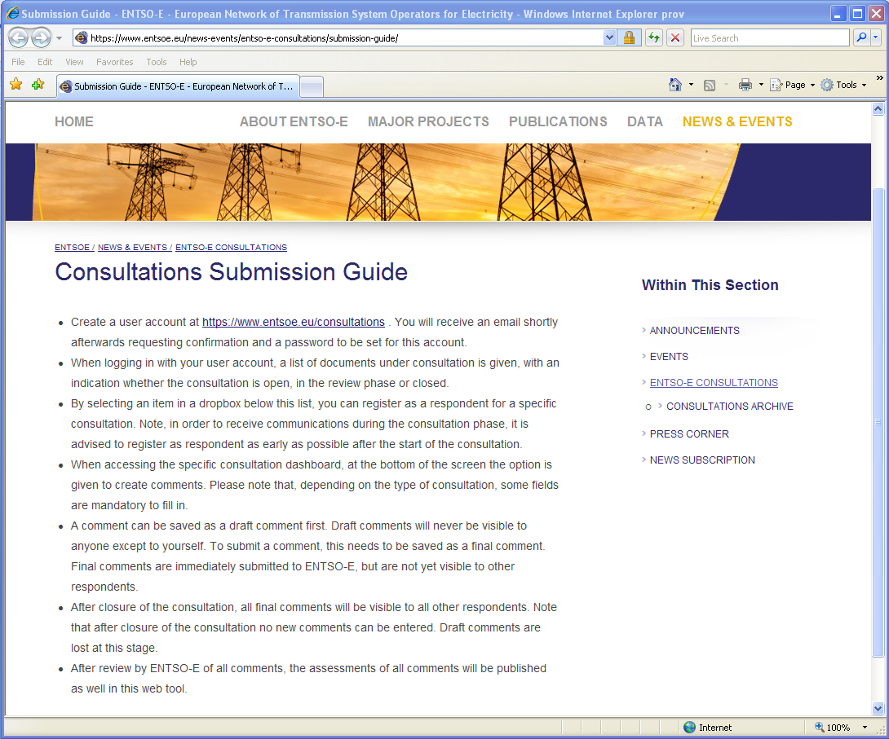
Comment Submission

Slide 40
Thank you for your attention

