Slide 1

DS3 Advisory Council
Dublin
23rd May 2019

Slide 2
Agenda - Morning
Topic | Time | Speaker
Introduction & Welcome | 10.30 | Jon O'Sullivan , EirGrid (10 mins)
Industry Presentation | 10.40 | Peter Harte, Statkraft - Reactive Power System Services (30 mins inc. discussion)
RoCoF Non-Compliance Study | 11:10 | Peter Wall, EirGrid (30 mins)
Rate of Change of Frequency (RoCoF) | 11:40 | Update: John Young , EirGrid (5 mins) Update: NIE Networks, ESB Networks (10 mins) Discussion: All (10 mins)
RoCoF Trial and SNSP Update | 12:05 | Ian Connaughton, EirGrid (30 mins)
Lunch & Networking (12.35 – 13.15)

Slide 3
Agenda - Afternoon
Topic | Time | Speaker
Industry Presentation | 13:15 | Rory Mullan, Mullangrid, Wind Curtailment (30 mins inc. discussion)
DS3 Programme Status Update (including System Services) | 13:45 | Presentation: Ian Connaughton, EirGrid (15 mins) Discussion: All (15 mins)
FlexTech Initiative | 14:15 | Presentation: John Lowry (10 mins) Discussion: All (10 mins)
AOB | 14.35 | All (10 mins)
Closing Remarks and Actions | 14.45 | Jon O'Sullivan, EirGrid (5 mins)
Session Closed (14:50)

Slide 4

Reactive Power Investment Signals
May 2019

Slide 5
Reactive Power Regimes
 | Location | Price | Quantity | Utilisation
Ireland – pre 2017 | TSO | Tariff | Conventional plant | No
Ireland now | Developers | Tariff x Scalar | Developers | No
UK | TSO sets region, developers find sites | Tender | TSO | Yes, £3/MVArh
Grid code sets a minimum level (c33% or 0.95pf) of reactive power from both conventional, renewable and interconnectors
Until now, only ESB built STATCOM and cap banks. Now anyone can (e.g. batteries). But Transmission forecast statement still lists STATCOM projects. Is this an open market? Who is competing? Is it a level playing field?

Slide 6
Locational Signals
New wind/solar/battery/offshore can all overspec reactive power for small cost if they happen to be at a useful reactive power location
Currently locational signal set to 1x on the Island of Ireland. Reactive power needs are clearly not so uniform.
Possible 2-3x locational scalar under consultation for Dublin. Again, hard to believe that all nodes in Dublin constraint list are equally short of reactive power.
Not always possible to deliver reactive power exactly where it is needed, so the concept of an “effectiveness factor” is crucial (e.g. 80% at 220kV Killonan, 40% at 38kV Limerick city).
Regional heat maps useful to identify total volume require.

Slide 7
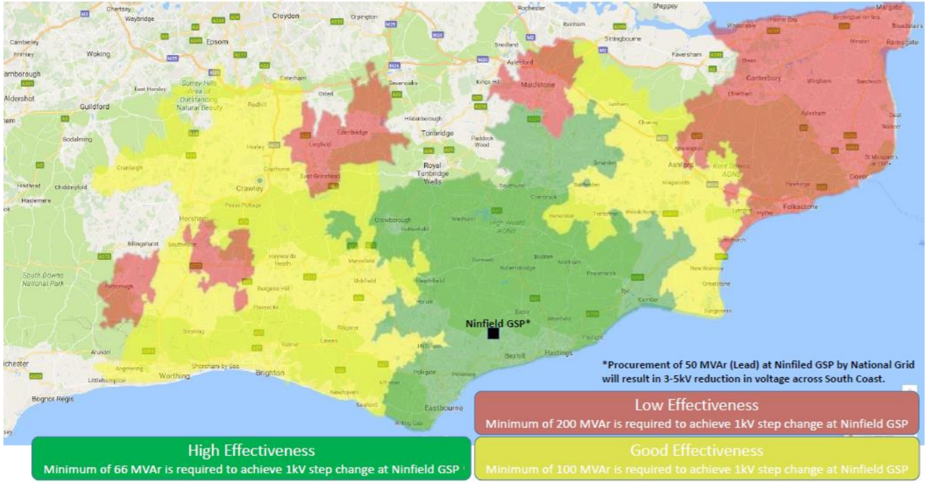
Sample of “Effectiveness” Map in UK
https://www.nationalgrideso.com/document/96401/download

Slide 8
Production Signals
The temporal scarcity scalar focusses capability to periods of high SNSP, but our initial modelling shows that there is no correlation between periods of SNSP and high reactive power needs/utilisation historically. Is this an appropriate signal?
The DRR product aims to incentivise fast response reactive power, but is so small it is irrelevant.
The application of the 2x scalar for producing reactive power when “(a) at zero MW and (b) when dispatched” is unclear. There seems to be an interpretation that “dispatched” means when the kV setpoint or power factor setpoint or reactive power setpoint results in the generator producing 25% or more of its total reactive power capability. But this 25% figure has never been consulted on or documented in the DS3 documentation.
Utilisation information (i.e. hours at various levels of reactive power) affects:
  1. The impact of the temporal scarcity scalar
  2. When the 2x product scalar kicks in
  3. Losses on traffos and generators

Slide 9
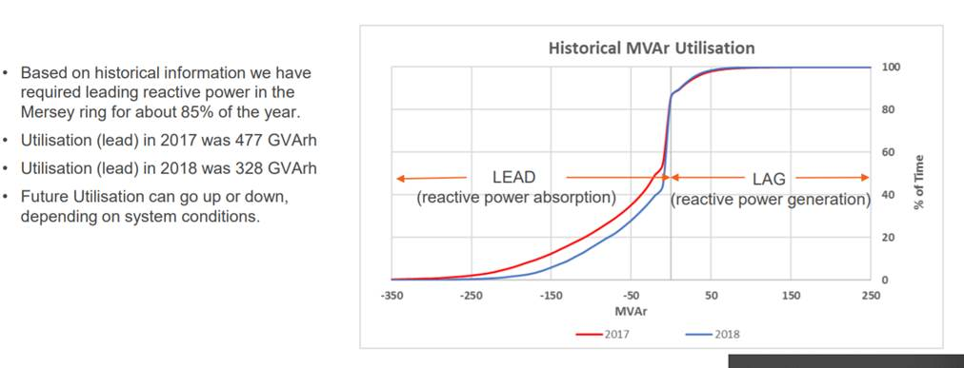
Sample of Utilisation Data available in UK
https://www.nationalgrideso.com/document/143241/download

Slide 10
Recommendations for 2020
Tweak the tariff regime to enable new investment (i.e. contract in advance, ensure sufficient duration contract)
Enable flow of information from the network planners in the TSO to the generators/developers
In the medium term, consider
  split the payment into capability and utilisation.
  Remove the Temporal Scarcity Scalar, replace with something a scalar that reflects actual temporal needs.
Extend the Transmission Forecast Statement to include heat map for regional reactive power needs over time, plus effectiveness factor by busbar (i.e. location and voltage)
Deploy the SSRP Locational Scalar based on information above
Start reporting on CO₂ emissions driven by DS3 or “non-energy actions”, with targets for reduction.

Slide 11
Recommendations for 2030
Reflect new CRU carbon strategy: Ensure that zero-carbon reactive power sources are prioritised (CO₂ scalar?)
Ancillary services today emit c.1MTCO₂ per year. Without mitigation, that could be 2x or 3x by 2030, even as “energy” emissions reduce by the same factor.
The goal for 2030 with 70% RES-E must be that conventional power is focussed on efficiently delivering for the 30% of non-renewable energy, and not used for system services. If batteries/DSU/interconnectors/peakers can deliver all reserves/ramping with zero-carbon, reactive power must also mainly come from zero-carbon sources.
Set out schedule of 110/38kV stations where nodal controllers mean DSO (Type A/B) connected reactive power capability has value
Include voltage and reactive power studies in the 2030 Sysflex and follow on studies to set out volumes, utilisation and locations in enough detail to allow an efficient investment signal for future reactive power needs.

Slide 13

RoCoF non-compliance study
Peter Wall, EirGrid

Slide 14
Study Overview
Analyse the effect of additional tripping from non compliant generation (NCG) after events with RoCoFs < -0.5 Hz/sec
  How much NCG causes frequency to go below 49 Hz?
  NCG level considered ranges from 10 to 250MW
Single Frequency Model (SFM) used for study with
2020 dispatches for 8760 hours (1Hz/s RoCoF and 7 sets)
Presence of NCG can result in customer load shedding for loss of LSI that causes RoCoF greater than 0.5Hz/s

Slide 15
Study Overview
Tomorrow’s Energy Scenario Schedules - 2020
  1 Hz/sec RoCoF constraint
  Minimum 7 sets
  No scheduled or forced outages considered
  8760 study intervals
Single Frequency Model (SFM)
  Single bus model
  Models frequency response of all online generators
  Aggregates responses to produce system frequency plot
  NCG trips 680ms after the initial event

Slide 16
SFM Model
Single busbar dynamic models of:
  EWIC and Moyle
  Variable generation
  Thermal generation
  Pumped storage and hydro plants
  Demand side units, batteries
Starts with supply demand balance
Applies trip of LSI followed by NCG
Models system frequency response

Slide 17
Summary of Dispatch
1144 Hours with RoCoF greater than 0.5 Hz/s
  1018 due to HVDC tripping on import
  126 due to synchronous generator tripping

Slide 18
Summary of Results
1144 hours of operation with RoCoF in excess of 0.5Hz/s
Results show that impact of NCG varies significantly depending on the nature of the dispatch for that hour
  10MW of NCG can cause frequency of less than 49Hz in some cases
  250MW of NCG does not for other cases
  Key drivers are inertia and level/response time of reserve
Case |  | Hours
Frequency <49 Hz | no NCG | 8
 | 10 to 150 MW of NCG | 432
 | 200 MW of NCG | 279
 | 250 MW of NCG | 277
Frequency >49 Hz | 250 MW of NCG | 148

Slide 19
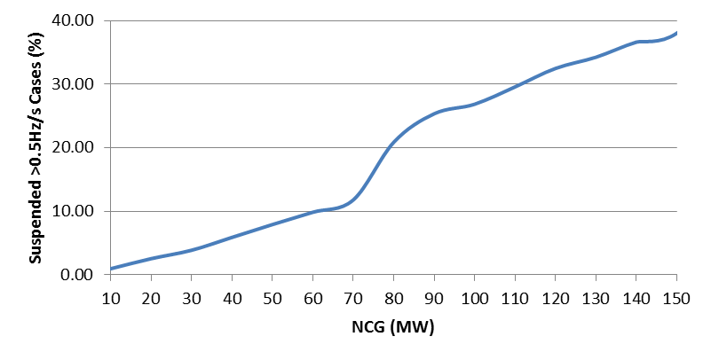
Real Time Assessment of Trial
Results indicate that any level of NCG could result in customer load shedding after LSI
Trial should incorporate real time assessment of whether customer load shedding would occur after LSI
Trial should be temporarily suspended if this is the case
Study results show that suspended cases will fall significantly if NCG is at 70MW

Slide 20
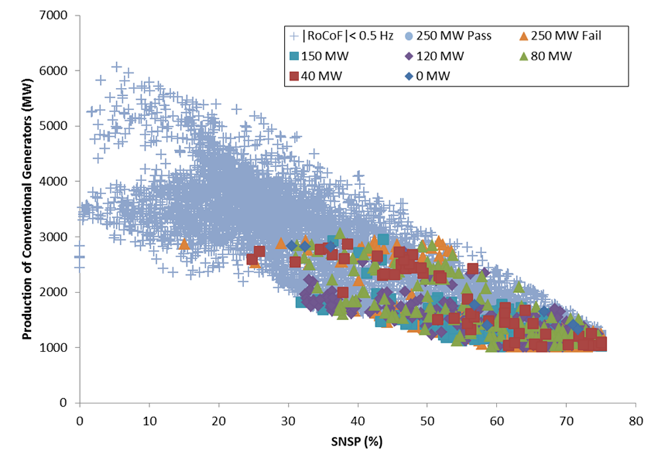
Sensitivity to System Conditions
Notable features:
  Conventional generation levels
  Spread of SNSP levels
  No grouping of vulnerable hours.

Slide 21
Sensitivity to Delay
The delay between the RoCoF occuring and the NCG tripping will change the results
Repeated a selection of cases with varied delay
  6 Cases for different levels of NCG
Looked at impact of delay on nadir

Slide 22
Sensitivity to Delay
Varied delay from 0ms to 680ms for one case
MW NCG not changed
Nadir shifts in time and frequency with reduced delay
  Faster tripping makes the nadir occur sooner (220ms)
  and have a larger deviation (13mHz)
Comparison of 0ms and 680ms cases
Increased
Delay

Slide 23
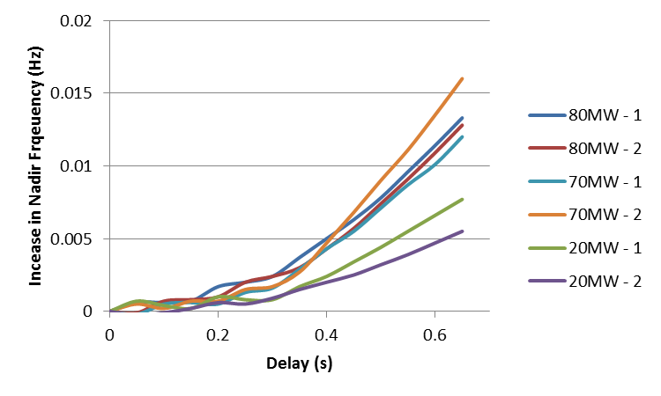
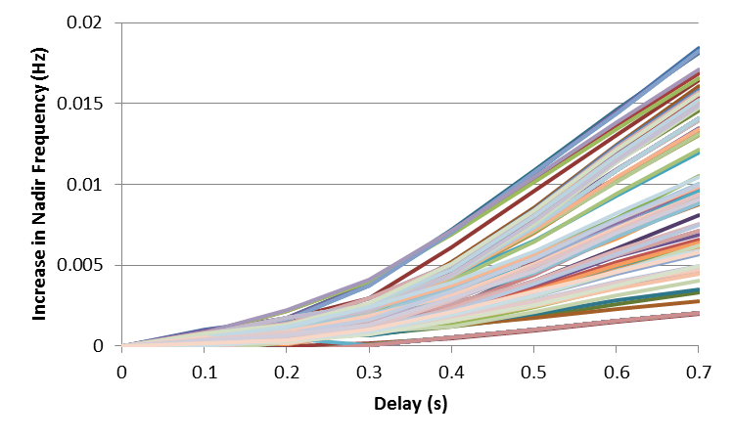
Sensitivity to Delay
Varied delay from 0ms to 680ms for 6 cases
Cases selected to represent different levels
of maximum NCG and dispatch
MW NCG not changed for each case
All Cases with <100MW NCG repeated
  (18mHz max change)

Slide 24
Sensitivity to NCG
Increased NCG from 0 to 10MW for 1 case
  Selected 70MW-2 for this test
This causes a 23mHz change in nadir
Indicates that delay change in range considered could cause at most a 10MW change in results
Increased
Delay

Slide 25
Recommendations
TSO to undertake process to determine level of non compliant generation with TSO/DSO/DNO that remains connected to the system
System non compliant generation of circa 70 MW would enable commencement of worthwhile 1 Hz/s trials
Continued efforts to reduce RoCoF non compliant generation toward 0 MW is required in the long term
If non compliant generation persists beyond 2020, similar studies should be repeated to reassess the level of exposure to customer load shedding

Slide 26
RoCof implementation programme
DS3 Advisory Council Update 23/05/19

Slide 27
LSG RoCoF Progress – Complete
All LSG sites >5MW have been changed to new RoCof setting
1120 MW of 1Hz/s RoCoF compliant Large Scale Generation (including sites that have connected since the programme started)
68 LSG sites have been changed

Slide 28
SSG RoCoF Implementation
Letters requesting G59 changes sent out 01 June 2018
SSG owners to acknowledge receipt
  Online or by return pre-paid envelope
For assurance purposes SSG owners to use G59 approved contractors
  List of approved contractors on NIE Networks website
G59 approved contractor list established following procurement exercise
  c20 contractors on list
SSG owners to make the changes by 30 September 2019
Costs associated with making the changes borne by SSG owners

Slide 29
SSG RoCoF – Current Status
Currently engaged in programme
  1261 SSG’s (90%) – 371 MW (93%)
    (1400 sites in total – 400 MW in total)
Already changed
  551 SSG’s (40%) – 174 MW (44%)

Slide 30
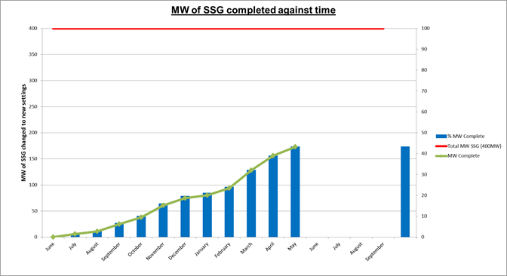
SSG RoCoF – Current Status

Slide 31
SSG RoCoF – Current Status

Slide 32
SSG RoCoF – Customer Interactions
  Non-responders
    Initial letter followed by October, February & April reminders
  Responders
    Initial letter followed by February and April reminders
  March – Four Information Evenings
  May – 2 additional information evenings
  May – G59 presence at Balmoral Show
  July – Final reminder to all SSG’s not changed
  October – De-energisation notices to all SSG’s not changed
  Dedicated G59 email address >600 contacts
  Dedicated phone number – 60 contacts following April reminder letter

Slide 33
SSG RoCoF – Non-Compliance
  All SSG’s have to comply with the D-Code
    UR and DCRP have confirmed this
  After 1st October non-compliant SSG’s will be subject to de-energisation notices
  Initial discussions with Ofgem re subsidy payments to non-compliant SSG’s
    UR involvement in further discussions
  Initial discussions with DfE re approach to SSG’s who are subject to Connection Agreement termination notices
    UR involvement in further discussions

Slide 34
DS3 RoCoF Project
John Young

Slide 35

RoCoF Status – May 2019
TOTAL (approx. 11,591 MW)
RoCoF 1Hz/s
8,838 MW (76%) complete
Conventional Generation (8,638MW total)
6,101 MW (71%) complete
IRE: 5,115/6,811 MW complete (76%)
NI: 986/1,827MW complete (54%)
19 out of 24 high and mid-priority units compliant
Engagement ongoing in both jurisdictions
Wind (2,223 MW total)
IRE: 1,266/1,266 MW complete (100%)
NI: 957/957 MW complete (100%)
2,223 MW (100%) complete
Roll-out completed in both jurisdictions as of January 2019
Small-scale/embedded (approx. 740 MW total)
514 MW (69%) complete
IRE: 340/340 MW complete (100%)
NI: 174/400 MW complete (44%)
Roll-out in IRE very close to completion
Roll-out in NI targeting Sept 2019 completion – Latest numbers from NIE Networks

Slide 36
RoCoF Trial and SNSP moves
Ian Connaughton

Slide 37
RoCoF Trial – SNSP 70% Trial
PHASE 1 ('As-is' Operational Constraint)
PHASE 2 (Updated Operational Constraints)
PHASE 3 (Increased SNSP 70% Trial)
50-100 Hrs
– Up to 3 Months
1Hz RoCoF and 200 Hrs 70% SNSP
– Up to 3 Months
>.5 for > 100 Hrs
– Up to 3 Months

Slide 38
RoCof Trial – Phase 1
PHASE 1 ('As-is' Operational Constraint)
Phase 1 - Change | Phase 1 Success Criteria
RoCoF Schedule & Dispatch of 0.5 > x ≤ 1.0 Hz/s | System Operation at > 0.5 Hz/s for between 50-100 hours.
Phase 1 - Prerequisites
Implementation of WSAT Enhancements – New contingencies to be agreed with OPRC
Control Centre Trial Plan | No system alerts or major events associated with trial.
Generator Implementation Stream reviewed and presented to OPRC in addition quantification from stakeholders in relation to 1 Hz/s non-compliant generation.
TSO-DSO implementation stream reviewed and presented to OPRC | WSAT aligns with expectations during trial - Any violations of frequency criteria to be reviewed in Phase 2 ex-post analysis.
Phase 1 - 'As-is'
Inertia Floor of 23,000 MWs
No Look Ahead Security Assessment Tool (LSAT)
65% SNSP
Min of 8 Units | Phase 1 ex-post analysis of system conditions when RoCoF above 0.5 Hz/s. Report approved by OPRC.
No Fast Frequency Response
No Ramping Tool

Slide 39
RoCof Trial – Phase 2
PHASE 2 (Updated Operational Constraints)
Phase 2 - Change | Phase 2 Success Criteria
Inertia Floor of 20,000 MWs | System Operation at > 0.5 Hz/s for > 100 hours.
Min Units of 7
Phase 2 - Prerequisites | No system alerts or major events associated with trial.
Approved Fast Frequency Response (FFR) Policy for Control Centres
Ramping Tool incorporated into Scheduling & Dispatch in the Control Centres | LSAT & VTT is fit for purpose.
Revised Control Centre Trial Plan
Introduction of LSAT & VTT into the Control Centres | WSAT aligns with expectations during trial - Any violations of frequency criteria to be reviewed in Phase 2 ex-post analysis.
Quantification from stakeholders in relation to 1 Hz/s non-compliant generation.
Phase 1 success & continuation of RoCoF Schedule & Dispatch at 0.5 > x ≤ 1.0 Hz/s
Phase 2 - 'As-is' | Phase 2 ex-post analysis of system conditions when RoCoF above 0.5 Hz/s. Report to be approved by OPRC.
65% SNSP

Slide 40
Phase 3 SNSP 70% Increase
PHASE 3 (Increased SNSP)
Phase 3 - Change
Trial of 70% SNSP & Inertia Floor of 17,500 MWs.
Phase 3 - Prerequisites
Introduction of change brought about by the successful completion of Phase 1 and Phase 2 Trials.
Completion of 75% studies

Slide 41
Lunch & Networking
12.35 – 13.15

Slide 42
Agenda - Afternoon
Topic | Time | Speaker
Industry Presentation | 13:15 | Rory Mullan, Mullangrid, Wind Curtailment (30 mins inc. discussion)
DS3 Programme Status Update (including System Services) | 13:45 | Presentation: Ian Connaughton, EirGrid (15 mins) Discussion: All (15 mins)
FlexTech Initiative | 14:15 | Presentation: TBC (10 mins) Discussion: All (10 mins)
AOB | 14.35 | All (10 mins)
Closing Remarks and Actions | 14.45 | Jon O'Sullivan, EirGrid (5 mins)
Session Closed (14:50)

Slide 43
Wind Farm Dispatch Down
Related Analysis
May 2019

Slide 44
Contents
Estimated Cost of 2018 Dispatch Down
Minimum Generation Analysis
Interconnector Analysis

Slide 45
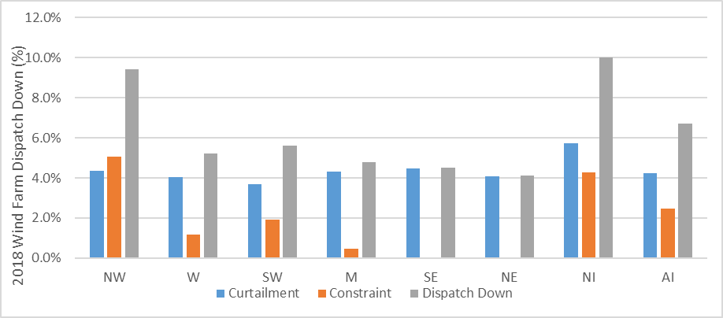
1. Estimation of Cost of 2018 Wind Farm Dispatch Down

Slide 46
2. Update on Minimum Generation Levels During Curtailment Events
Generator |  |  | Fuel Type | MEC (MW) | Declared Min Gen Level (MW) | Avg Deviation from Setpoint Feb/March 19 | Avg Generation Level During Curtailment Events (MW)
 |  |  |  |  |  |  | Q1 2019 | 2018 | 2017 | 2016 | 2015 | 2012-14
Republic of Ireland | Must Run Plants | Dublin Bay¹ | Gas/DO | 415 | 130 | 7.3% | 171 | 228 | 252 | 257 | 248 | 271
 |  | Huntstown 2 ² | Gas/DO | 412 | 121 | 7.4% | 181 | 140 | 151 | 158 | 176 | 181
 |  | Huntstown 1 ³ | Gas/DO | 352 | 120 | 2.2% | 156 | 141 | 140 | 191 | 195 | 181
 |  | Poolbeg A ⁴ | Gas/DO | 230 | 120 | - | 124 | 124 | 123 | 129 | 236 | 242
 |  | Poolbeg B ⁴ | Gas/DO | 230 | 77 | - | 0 | 117 | 94 | 121
 |  | Tynagh | Gas/DO | 404 | 194 | 2.2% | 205 | 210 | 215 | 224 | 199 | 198
 |  | Moneypoint 1 ⁵ | Coal/HFO | 285 | 99 | 1.8% | 102 | 119 | 115 | 121 | 117 | 121
 |  | Moneypoint 2 ⁵ | Coal/HFO | 285 | 99 | - | 0 | 112 | 116 | 121 | 118 | 120
 |  | Moneypoint 3 ⁵ | Coal/HFO | 285 | 99 | 0.7% | 103 | 117 | 121 | 127 | 120 | 115
 |  | Aghada 1 | Gas | 258 | 36 | - | 0 | 38 | 0 | 0 | 0 | 0
 |  | Aghada 2 ⁶ | Gas/DO | 432 | 130 | 7.7% | 158 | 197 | 216 | 207 | 218 | 206
 |  | Tarbert 3 | HFO | 241 | 35 | 0.2% | 35 | 35 | 0 | 0 | 35 | 0
 |  | Tarbert 4 | HFO | 241 | 35 | - | 0 | 38 | 0 | 0 | 0 | 0
 |  | Whitegate ⁷ | Gas/DO | 445 | 160 | 6.4% | 190 | 192 | 202 | 225 | 187 | 188
 |  | Great Island ⁸ | Gas/DO | 464 | 165 | 2.1% | 175 | 193 | 202 | 255 | 257 | 0
 |  | Sealrock 1 | Gas/DO | 80 | 40 | 0.6% | 69 | 70 | 71 | 76 | 74 | 76
 |  | Sealrock 2 | Gas/DO | 81 | 40 | 0.8% | 70 | 70 | 73 | 78 | 75 | 76
 | Priority Dispatch Plants | Edenderry | Peat/Biomass | 118 | 41 | 0.8% | 63 | 65 | 62 | 74 | 75 | 85
 |  | Lough Ree ⁹ | Peat | 91 | 32 | 3.9% | 57 | 62 | 74 | 76 | 79 | 75
 |  | West Offaly ¹⁰ | Peat | 137 | 48 | 4.1% | 81 | 86 | 88 | 96 | 101 | 101
 | Average |  |  |  | 91 | 3.2% | 121 | 118 | 136 | 149 | 148 | 149
 | Average Total ROI Min Gen During Curtailment Events (MW) |  |  |  |  |  | 1135 | 1227 | 1329 | 1403 | 1280 | 1329
Northern Ireland | Must Run Plants | Ballylumford B4 | Gas/HFO | 144 | 54 | - | 0 | 54 | 0 | 56 | 0 | 0
 |  | Ballylumford B5 | Gas/HFO | 147 | 54 | - | 0 | 54 | 55 | 57 | 0 | 0
 |  | Ballylumford B10 | Gas/HFO | 101 | 63 | - | 69 | 66 | 63 | 62 | 64 | 65
 |  | Ballylumford B31 | Gas/HFO | 247 | 113 | 3.7% | 134 | 114 | 121 | 106 | 121 | 110
 |  | Ballylumford B32 | Gas/HFO | 247 | 113 | 0.8% | 132 | 127 | 122 | 127 | 0 | 83
 |  | Kilroot K1 | HFO/Coal | 255 | 93 | 2.5% | 110 | 113 | 113 | 107 | 117 | 122
 |  | Kilroot K2 | HFO/Coal | 258 | 93 | - | 0 | 115 | 106 | 108 | 119 | 118
 |  | Coolkeeragh | Gas/DO | 425 | 260 | - | 293 | 289 | 280 | 283 | 271 | 264
 | Average |  |  |  | 100 | 2.3% | 148 | 117 | 123 | 113 | 124 | 117
 | Average Total NI Min Gen During Curtailment Events (MW) |  |  |  |  |  | 370 | 419 | 467 | 488 | 470 | 411
Review of operation of must run plants during curtailment events indicates that some of the plants (highlighted in yellow) are consistently operating at levels well above their declared minimum generation levels over the past 7 years
1 = Min Gen of Dublin Bay plant was previously 203MW but reduced in 2018.
2 = Min Gen of Huntstown 2 plant was previously 140MW but reduced in 2016.
3 = Min Gen of Huntstown 1 plant was previously 170MW but reduced in 2017.
4 = Min Gen of both Poolbeg plants was previously 105MW but reduced to 66MW in 2017 before being increased up to 77MW in 2018. Min Gen of Poolbeg A increased to 120MW in 2019
5 = Min Gen of 3 Moneypoint plants were previously 99MW each, were reduced to 75MW in 2018, increased back to 99MW in 2019
6 = Min Gen of Aghada 2 plant was previously 216MW but was reduced to 130MW in 2018
7 = Min Gen of Whitegate plant was previously 180MW but was reduced to 160MW in 2018
8 = Min Gen of Great Island plant was previously 230MW but reduced to 203MW in 2016 and 165MW in 2017.
9 = Min Gen of Lough Ree plant was previously 71MW but reduced in 2017.
10 = Min Gen of West Offaly plant was previously 48MW but increased to 77MW in 2015, before being reduced to 48MW again in 2018

Slide 47
2. Excess Must Run Conventional Generation
During Curtailment Events in Q1 2019
ROI Excess Reserve-Q1 2019
SEMO Code | Unit Name | Average Output above Declared Min-Gen per Curtailment Event
GU_400270 | Moneypoint 1 Generator Unit | 4.23
GU_400271 | Moneypoint 2 Generator Unit | 0.00
GU_400272 | Moneypoint 3 Generator Unit | 4.30
GU_400180 | Aghada Generator Unit | 0.00
GU_400181 | AGHADA CT11 Generator Unit | 0.00
GU_400182 | AGHADA CT12 Generator Unit | 0.00
GU_400183 | AGHADA CT14 Generator Unit | 0.00
GU_400850 | Aghada 2 Generator Unit | 31.31
GU_400762 | Great Island CCGT | 20.56
GU_400752 | Tarbert 3 Generator Unit | 0.59
GU_400753 | Tarbert 4 Generator Unit | 0.00
GU_400930 | Bord Gais ROI - Whitegate Generator Unit | 30.02
GU_400530 | Tynagh Generator Unit | 17.62
GU_400500 | Dublin Bay Generator Unit | 41.45
GU_400480 | HPC1 Generation Unit | 36.28
GU_400540 | Huntstown 2 | 59.60
GU_400120 | Sealrock 3 Generator Unit | 28.81
GU_400121 | Sealrock 4 Generator Unit | 29.73
GU_400300 | Marina Generator Unit | 0.00
GU_400325 | Poolbeg Generator Unit B | 0.00
GU_400324 | Poolbeg Generator Unit A | 3.50
GU_400240 | Lanesboro | 24.79
GU_400370 | Shannonbridge Generator Unit | 33.01
GU_401860 | Edenderry Generator Unit 1 | 21.48
 | Total Average per Curtailment Event | 270.83
 | Negative Reserve | 100
 | Total Excess | 170.83
NI Excess Reserve-Q1 2019
SEMO Code | Unit Name | Average Output above Declared Min-Gen per Curtailment Event
GU_500283 | Ballylumford GT1 | 0.0
GU_500284 | Ballylumford GT2 | 0.0
GU_500282 | Ballylumford B4 | 0.0
GU_500281 | Ballylumford 5 Generator Unit (B5) | 0.0
GU_500130 | Ballylumford 1 Generator Unit (B31) | 24.7
GU_500131 | Ballylumford Generator 2 Unit (B32) | 22.1
GU_500140 | Ballylumford Generator 3 Unit (B10) | 6.0
GU_500822 | AES Kilroot - K1 | 17.4
GU_500823 | AES Kilroot - K2 | 0.0
GU_500824 | AES Kilroot Ltd Power GT1 | 0.0
GU_500825 | AES Kilroot Ltd Power GT2 | 0.0
GU_500041 | Coolkeeragh Generator Unit | 0.0
GU_500040 | Coolkeeragh ESB CCGT Generator Unit | 40.2
Total Average per Curtailment Event |  | 53.3
Negative Reserve |  | 50.0
Total Excess |  | 3.3

Slide 48
2. Example of Conventional Plants Running
Considerably Higher Than The Declared Min Gen
Generator | Min Gen MW | Avg Generation During Event MW
Moneypoint 1 | 99 | 105
Sealrock 1 | 40 | 82
Sealrock 2 | 40 | 81
Aghada 2 | 130 | 232
Great Island | 165 | 255
Whitegate | 160 | 270
Tynagh | 194 | 222
Dublin Bay | 130 | 191
Huntstown 1 | 120 | 172
Lough Ree | 32 | 91
West Offaly | 48 | 137
Edenderry | 41 | 116
Total | 1199 | 1955

Slide 49
2. Example of Conventional Plants Running Close to Their Declared Min Gen
Generator | Min Gen MW | Avg Generation During Event MW
Moneypoint 1 | 99 | 100
Sealrock 1 | 40 | 69
Sealrock 2 | 40 | 70
Aghada 2 | 130 | 134
Great Island | 165 | 169
Dublin Bay | 130 | 155
Huntstown 1 | 120 | 168
Lough Ree | 32 | 35
West Offaly | 48 | 67
Edenderry | 41 | 55
Total | 845 | 1023

Slide 50
2. Example of How Conventional Plants were Running
on Average Vs Declared Min Gen
Generator | Min Gen MW | Avg Generation During Event MW
Moneypoint 1 | 99 | 105
Sealrock 1 | 40 | 73
Sealrock 2 | 40 | 73
Aghada 2 | 130 | 149
Whitegate | 160 | 169
Dublin Bay | 130 | 180
Huntstown 1 | 120 | 168
Lough Ree | 32 | 64
West Offaly | 48 | 69
Edenderry | 41 | 56
Total | 840 | 1108

Slide 51
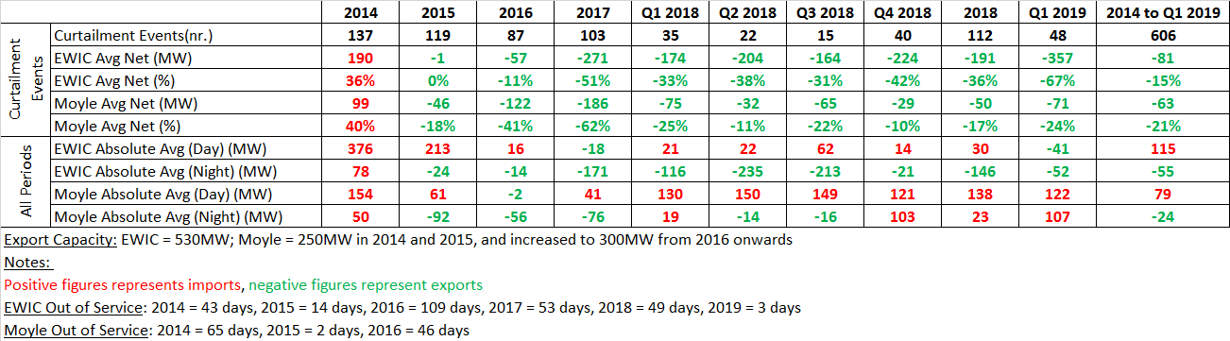
3. Update on Interconnector Activity During Curtailment Events

Slide 52
DS3 Programme Status Update – May 2019
Ian Connaughton

Slide 53
DS3 Highlights
DS3 System Services Uncapped Procurement Gate 1 OJEU launched – Mar 19
Volume Capped PQQ closed – Apr 19
Volume Capped Bidders Conference – Apr 19
DS3 System Services Uncapped Procurement Gate 1 Bidders Conference – Apr 19
Completed RoCoF Non Compliance all Island study and report - Apr 19

Slide 54
DS3 Major Deliverables for Remainder of Year
Complete DS3 QTP, Volume Capped and Gate 1 procurements
Complete 75%, 1Hz, 20,000MW.s, 8 Set Study
New Policy and Control Centre tools
Progress to 1 Hz/s RoCoF operational trial

Slide 55
Work Stream 1 – 65% to 70% SNSP
Grouping | Status |  | Delivery
Operational Change
RoCoF transition to 1Hz/s |  | Wind complete, SCG in NI 40%, Some conventional units not moved yet | Q3 2019
Inertia Floor – 20,000 MWs |  | Policy development underway and on track for delivery. Cannot move without change to 1 Hz/s RoCoF. | Q3 2019
Operational Policy
Ramping Policy |  | Completed in March 2018 | Q1 2018
SNSP 70% Policy |  | Studies underway for 70% SNSP Policy need by Q1 2020 | Q1 2020
Operational Reserves Policy |  | Study underway - policy needed for phase 2 of RoCof Trial Q1 2020 | Q1 2020
RoCoF & Inertia Floor Policy |  | Study underway - Policy needed in advance of RoCoF Trial phase 1 Q3 2019 | Q3 2019
Control Centre Tools
Ramping Tool |  | Order of magnitude assessment form Vendor Under way, confirmation of delivery dates expected with assessment | Q4 2019
Look Ahead WSAT |  | PQQ has been completed Tender documentation Approved | Q4 2019
System Services
Volume Uncapped – Gate 1 Volume Capped |  | Gate 1 under way, The 12 products will be refreshed Contract execution is September 1st 2019 Volume Capped under way Contract execution is September 1st 2019 | Q3 2018

Slide 56
Work Stream 2 – 70% to 75% SNSP
Grouping | Status | Update | Delivery
Operational Change
Implement OFGS enduring |  | Studies have initiated and on schedule to be completed in late Q1/early Q2 2019. Rollout of new settings to being following this. | Q4 2019
Inertia Floor 17,500 MWs |  | Dependent on study and successful trial of 20,000 MWs. | Q1 2020
Minimum Units Online - 7 |  | Dependent on successful delivery of Voltage Trajectory Tool. | Q1 2020
Operational Policy
Min Sets Policy (Voltage & Inertia) |  | Study underway plan for Oct 2019 delivery, Min sets policy to follow needed for Q1 2020 | Q1 2020
SNSP 75% Policy |  | Study underway plan for Oct 2019 delivery 75% policy to follow | Q1 2020
VDIF Policy |  | Work completed in 2018. Put on hold pending EU-SysFlex analysis and further information on DRR and FPFAPR product volumes in Q3 2019. | Q4 2019
Control Centre Tools
Voltage Trajectory Tool |  | Tender PQQ evaluation – Complete. Candidates identified to progress to tender stage. | Q1 2020
System Services
12 existing services + DRR + FPFAPR |  | The product definitions for DRR and FPFAPR are the process of being refined with a view to publishing the technical requirements. They can be procured at a subsequent gate of the Qualification System as needed. | Q3 2020

Slide 57
DS3 Other Items
Settlement |  | Update | Date
Market to Physical |  | System changes on track for June delivery. There is a dependence on Market resettlement data from Oct 2018 onwards being available before MTP resettlement for that period can taker place. | Q2 2018
Other |  | Update
SNSP Forecast |  | Development complete, data validation complete. Final stage to publish on web site underway | Q2 2019
Renewable Integration
Qualification Trial Process |  | Tender submissions closed on the 5/4/2019 The tender evaluation is currently ongoing with contract sign off due to take place the 31/5/2019. It is expected 5 trials will pass through the evaluation stage. | Staggered Delivery
Nodal Controller – IE |  | NC will be officially handed over to EIRGRID at the end of April following delivery of a signed off full specification and testing reports. Once reviewed a testing procedure will be drafted for approval and EIRGRID will begin testing the NC on an agreed timeline of approx. 4 weeks. Some concern about level of wind for testing. A joint report with ESBN will be submitted to the CRU following testing. | Q3 2019
Nodal Controller – NI |  | Further discussions to be held with NIE around the control of the NC. | 2020

Slide 58
RoCoF Trial Phase 1
RoCoF Trial Phase 2
70%
Perm
2019 |  |  |  | 2020
Q1 | Q2 | Q3 | Q4 | Q1 | Q2 | Q3 | Q4
SNSP 70%
Trial
SNSP 75%
Trial
1 Sep 2019
Contract Execution
75%
Perm
SS Gate 1 Procurement
Gate 2 – 1 April 2020
SS Volume Capped Procurement
System Services Procurement
1 Sep 2019
Contract Execution
  Qualifier Trial Process
September 2019
For 2019 Trial start
MTP System Changes
June 2019
Resettlement
System Changes
Operational Reserves Policy
Q2 Min Sets Policy
SNSP 70% Policy
SNSP 75% Policy
  Operational Policy
Q3 RoCoF and Inertia Floor Policy
Inertia Floor 17,500 MWs
Q1 Implement Enduring OFGS
VDIF Policy
  Operational Changes
Operational Implementation
Q4 Ramping Tool
Inertia Floor 20,000 MWs
Minimum units - 7
  Control Centre Tools
Q1 Voltage Trajectory Tool
RoCoF 1Hz/s
Q4 Look Ahead WSAT

Slide 59
System Services Procurement

Slide 60
System Services – Volume Uncapped Gate 1
Services in Scope
12 services being procured
All except DRR and FPFAPR
Existing Providers
Can tender to amend existing capability
Can tender for additional services
New Providers
Can tender for any service where 'proven'

Slide 61
System Services – Volume Uncapped Gate 1
Tender Submission Deadline –
24th May 2019
Final Date for Testing –
21st June 2019
Test Report Approval Deadline –
19th July 2019
Contract Execution –
1st September 2019
Agree Contractual Schedule 9 –
31st July 2019 (approx.)

Slide 62
System Services – Volume Uncapped Gate 1
Activities to Date
OJEU Notice issued – 29th March 2019
40+ attendees at Bidders’ Conference – 11th April 2019
98 pre-tender clarifications issued on schedule –
10th May 2019

Slide 63
System Services – Volume Uncapped Gate 1
Next Steps
Initial Procurement assessment commences – 27th May 2019
Technical evaluation commences –
4th June 2019

Slide 64
Fixed Contracts (Volume Capped)
Investable
6 year contract (end date August 2027)
Rates fixed for duration of contract
Flat predictable payment (unless performance is poor)
Requirements
Should be almost always available to provide services
Provide under-frequency response from 300 ms up to 20 minutes
Provide some over-frequency response from 300 ms up to 90 seconds
Auction
Cheapest 100 MW is procured
Pay as bid
Regulated Tariff rates used to set bid cap

Slide 65
Fixed Contracts Timelines
Develop PQQ and Publish OJEU/PQQ
15 Feb - 28 Feb 2019
PQQ info and PQQ Submission
28 Feb - 12 April 2019
PQQ evaluation
15 April – 17 May 2019
Evaluate Tenders 9 July - 9 Aug 2019
Open Tender and provide info
31 May - 05 July 2019
Submit bonds and sign contracts
16 Aug 2019 - 30 Aug 2019
Indicative

Slide 66
System Services – Volume Capped
Activities to Date
OJEU Notice issued – 7th March 2019
Bidders’ Conference – 14th March 2019
134 pre-tender clarifications issued –
5th April 2019
Protocol, Contract, and TSS details available for review

Slide 67
System Services – Volume Capped
Next Steps
Notification of PQQ outcomes
Info on Bid pricing mechanism and payments
Info on I-SEM interactions
Launch of Tender stage
Bidders Conference

Slide 68
FlexTech
Flexible Technology Integration Initiative
John Lowry

Slide 69












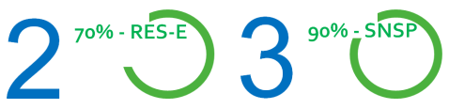
2030 Challenge – Future System Operation Complexity
National Electrification
Power system dominated by weather dependent renewables
Demand Side Participation
Less Thermal Plant
Increase in system demand
Power system shift from centralised power stations to a distributed environment
Large scale deployment of battery storage
Centralised
TSO
Distributed
DSO
Greater Interconnection

Slide 70
FlexTech Initiative
Flexible Technology Integration Initiative
A platform of engagement with industry with the objective of removing barriers to renewable integration
A collaborative initiative addressing a range of topics under a single banner.
It shall consist of internal and external aspects
  EirGrid Group wide Working Groups – with SME Panel
  An industry forum - Addressing industry concerns!
  TSO/ DSO/ DNO Task Force - Working together!
Inform future policy, standards, QTP, system solution development and cross sectoral challenges.
Notes:
As renewable generation displaces conventional generation on the system, we need System Services to come from sources other than conventional generation, with greater reliance on variable sources of electricity.

Slide 71





FlexTech Working Groups
Flexible Technology Integration Initiative
RENEWABLE/SSG
HYBRID
STORAGE
DATA CENTRES
DSM
Renewable/ SSG
Colm MacManus
Kate Hanley
Eoin Clifford
Mark Gormley
Renewable/SSG
Colm MacManus
DSM
Mark Gormley
Hybrid
Kate Hanley
Data Centres
Tom Gallery
Storage
Eoin Clifford
Programme Management - Innovation
SME Panel
MARKET DESIGN
CUSTOMER RELATIONS
COMMUNICATINS
NEAR/ REALTIME
LEGAL
PLANNING – TNP/AP
SCENARIO PLANNING
MARKET REGISTRATION
REGULATION
SYSTEM SUPPORT
CONNECTIONS & CHARGING
IS/METERING
NEW CONNECTIONS
TRANSMISSION SYSTEM ENGINEER
INNOVATION

Slide 72
FlexTech Forum
Flexible Technology Integration Initiative
Flex-Tech Initiative Industry forum is to act as a consultative body with respect to solving a broad range of challenges associated with the integration of technology.
Industry forums shall take place bi-annually
This will be followed by a consultation process with industry our SO partners and regulators
First Forum to be held on the 6th of June.
Notes:
As renewable generation displaces conventional generation on the system, we need System Services to come from sources other than conventional generation, with greater reliance on variable sources of electricity.

Slide 73





FlexTech - Implementation
Flexible Technology Integration Initiative
Flex-Tech Industry Forum
WGs
Consultation
TSO
Business Planning,
BAU & QTP
Recommendation Paper
DSO/DNO Implementation
Regulatory Decisions

Slide 74
FlexTech - Linking it all together
Flexible Technology Integration Initiative
Engage Industry, Regulators and Network Operators to address technical, policy regulatory and commercial issues effecting integration of renewables.
Inform scope development of future Qualification Trials
Inform solution development and implementation within EirGrid and SONI
Input to Business Planning Process & Business as usual
Collaborate with DSO/DNO on specific challenges
Regulation
TSO/DSO/DNO
QTP
BAU
Business Planning
Projects

Slide 75
AOB

